Slide 1
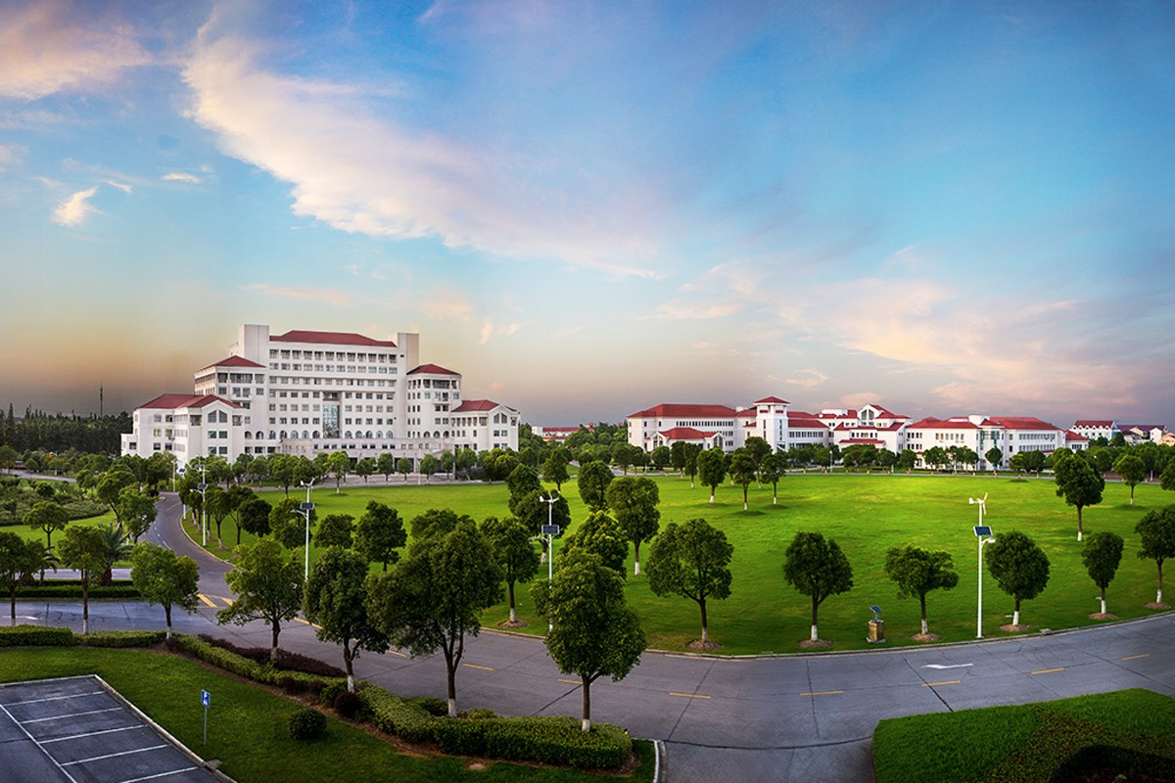

自然语言处理
廉洁，lianjie@shnu.edu.cn

Slide 2

Lecture Plan
1
How to represent a word
2
Word2vec
3
Evaluation Methods

Slide 3
How do we represent the meaning of a word?
Definition: meaning (Webster dictionary)
• the idea that is represented by a word, phrase, etc.
• the idea that a person wants to express by using words, signs, etc.
• the idea that is expressed in a work of writing, art, etc. Commonest linguistic way of thinking of meaning:
signifier (symbol) ⟺ signified (idea or thing)
= denotational semantics

Slide 4
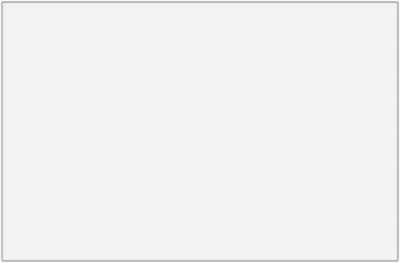
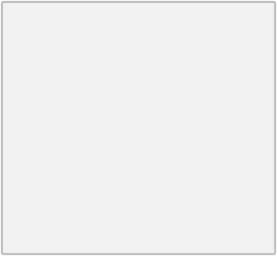
How do we have usable meaning in a computer?
Common solution: Use e.g. WordNet, a thesaurus containing lists of synonym sets and hypernyms (“is a” relationships).
e.g. synonym sets containing “good”:
e.g. hypernyms of “panda”:
from nltk.corpus import wordnet as wn
poses = { 'n': 'noun', 'v': 'verb', 's' : 'adj (s)', 'a' : 'adj', 'r' : 'adv'} for synset in wn.synsets("good"):
print("{}: {}".format(poses[synset.pos()], ", ".join([l.name() for l in synset.lemmas()])))
from nltk.corpus import wordnet as wn panda = wn.synset("panda.n.01") hyper = lambda s: s.hypernyms() list(panda.closure(hyper))
noun: good
noun: good, goodness
noun: good, goodness
noun: commodity, trade_good , good
adj : good
adj (sat): full, good
adj : good
adj (sat): estimable, good, honorable, respectable
adj (sat): beneficial, good
adj (sat): good
adj (sat): good, just, upright
…
adverb: well, good
adverb: thoroughly, soundly, good
[Synset('procyonid.n.01'), Synset('carnivore.n.01'), Synset('placental.n.01'), Synset('mammal.n.01'), Synset('vertebrate.n.01'), Synset('chordate.n.01'), Synset('animal.n.01'), Synset('organism.n.01'), Synset('living_thing.n.01'), Synset('whole.n.02'),
Synset('object.n.01'), Synset('physical_entity.n.01'), Synset('entity.n.01')]

Slide 5
Problems with resources like WordNet
• Great as a resource but missing nuance
• e.g. “proficient” is listed as a synonym for “good” .
This is only correct in some contexts.
• Missing new meanings of words
• e.g., wicked, badass, nifty, wizard, genius, ninja, bombest
• Impossible to keep up-to-date!
• Subjective
• Requires human labor to create and adapt
• Can’t compute accurate word similarity

Slide 6
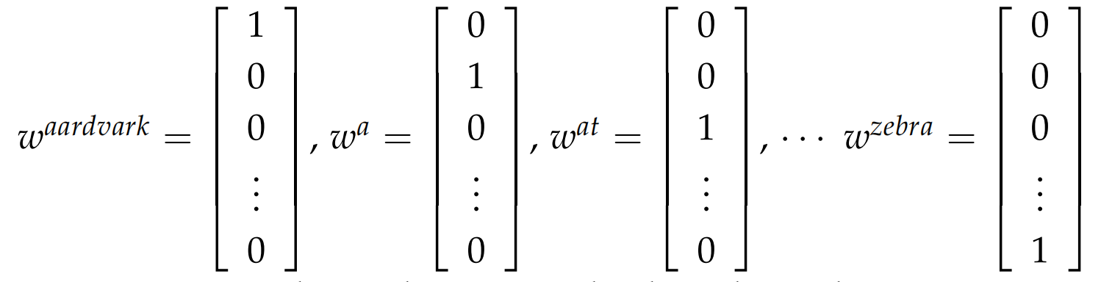
Representing words as discrete symbols
In traditional NLP, we regard words as discrete symbols: hotel, conference, motel – a localist representation
Means one 1, the rest 0s
Words can be represented by one-hot vectors:
motel = [0 0 0 0 0 0 0 0 0 0 1 0 0 0 0]
hotel = [0 0 0 0 0 0 0 1 0 0 0 0 0 0 0]
Vector dimension = number of words in vocabulary (e.g., 500,000)

Slide 7
Representing words as discrete symbols
Example: in web search, if user searches for “Seattle motel”, we would like to match documents containing “Seattle hotel” .
But:
motel = [0 0 0 0 0 0 0 0 0 0 1 0 0 0 0]
hotel = [0 0 0 0 0 0 0 1 0 0 0 0 0 0 0]
These two vectors are orthogonal.
There is no natural notion of similarity for one-hot vectors!
Solution:
• Could try to rely on WordNet’s list of synonyms to get similarity?
• But it is well-known to fail badly: incompleteness, etc.
• Instead: learn to encode similarity in the vectors themselves

Slide 8
SVD-based method
Assumption:
words that are related will often appear in the same documents.
"banks", "bonds", "stocks", "money", etc. are probably likely to appear together.
"banks", "octopus", "banana", and "hockey" would probably not consistently appear together.
Using Word-Word Co-occurrence Matrix:
Generate |V| × |V| co-occurrence matrix, X.
Apply SVD on X to get X = USV^{T}.
Select the first k columns of U to get a k-dimensional word vectors.

Slide 9
Window based co-occurrence matrix
Window length 1 (more common: 5–10)
Symmetric (irrelevant whether left or right context)
Example corpus:
I like deep learning.
I like NLP.
I enjoy flying.
perform SVD on X(co-occurence matrix), observe the singular values (the diagonal entries in the resulting S matrix), and cut them off at some index k-based on the desired percentage variance captured

Slide 10
Window based co-occurrence matrix
Example corpus:
I like deep learning.
I like NLP.
I enjoy flying.
counts | I | like | enjoy | deep | learning | NLP | flying | .
I | 0 | 2 | 1 | 0 | 0 | 0 | 0 | 0
like | 2 | 0 | 0 | 1 | 0 | 1 | 0 | 0
enjoy | 1 | 0 | 0 | 0 | 0 | 0 | 1 | 0
deep | 0 | 1 | 0 | 0 | 1 | 0 | 0 | 0
learning | 0 | 0 | 0 | 1 | 0 | 0 | 0 | 1
NLP | 0 | 1 | 0 | 0 | 0 | 0 | 0 | 1
flying | 0 | 0 | 1 | 0 | 0 | 0 | 0 | 1
. | 0 | 0 | 0 | 0 | 1 | 1 | 1 | 0

Slide 11
Problems with simple co-occurrence vectors
The dimensions of the matrix change very often (new words are added very frequently and corpus changes in size).
The matrix is extremely sparse since most words do not co-occur.
The matrix is very high dimensional in general (≈ 106 × 106)
Quadratic cost to train (i.e. to perform SVD)
Requires the incorporation of some hacks on X to account for the drastic imbalance in word frequency
Subsequent classification models have sparsity issues

Slide 12
Solution: Low dimensional vectors
• Ignore function words such as "the", "he", "has", etc.
• Apply a ramp window – i.e. weight the co-occurrence count based on distance between the words in the document.
• Use Pearson correlation and set negative counts to 0 instead of using just raw count.

Slide 13
Interesting syntactic patterns emerge in the vectors
CHOOSING
CHOOSE CHOSCEHNOSE
STOLEN STEAL
STOLE
STEALING
SPOKE
SPEAK
TAKE
SPOKEN
TAKEN
SPEAKING
TAKING TOOK
THROW^{T}N^{HR}T^{O}H^{W}REW
THROWING
SHOWN
SHOWED SHOWING
EATEN_{T}
ATE
EATING
SHOW
GROWN
GROW
GREW
GROWING
COALS model from
An Improved Model of Semantic Similarity Based on Lexical Co-Occurrence Rohde et al. ms., 2005

Slide 14
Interesting syntactic patterns emerge in the vectors
DRIVER
JANITOR STUDENT
DRIVE
SWIMMER
CLEAN
TEACHER
DOCTOR
BRIDE
SWIM
PRIEST
LEARN
TEACH
MARRY
TREAT
PRAY
COALS model from
An Improved Model of Semantic Similarity Based on Lexical Co-Occurrence Rohde et al. ms., 2005

Slide 15


Representing words by their context
• Distributional semantics : A word’s meaning is given by the words that frequently appear close-by
• “You shall know a word by the company it keeps” (J. R. Firth 1957: 11)
• One of the most successful ideas of modern statistical NLP!
• When a word w appears in a text, its context is the set of words that appear nearby (within a fixed-size window).
• Use the many contexts of w to build up a representation of w
…government debt problems turning into banking crises as happened in 2009… …saying that Europe needs unified banking regulation to replace the hodgepodge…
…India has just given its banking system a shot in the arm…
These context words will represent banking

Slide 16
Word vectors
We will build a dense vector for each word, chosen so that it is similar to vectors of words that appear in similar contexts
0.286
0.792
−0.177
−0.107
0.109
−0.542
0.349
0.271
banking =
Note: word vectors are sometimes called word embeddings or word representations. They are a distributed representation.

Slide 17
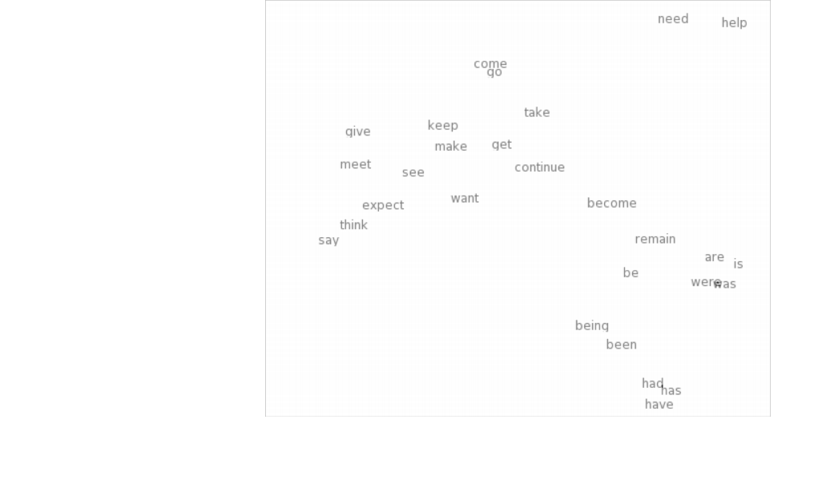
Word meaning as a neural word vector – visualization
0.286
0.792
−0.177
−0.107
0.109
−0.542
0.349
0.271
0.487
expect =

Slide 18
Word2vec
Word2vec (Mikolov et al. 2013) is a framework for learning word vectors
Idea:
• We have a large corpus of text
• Every word in a fixed vocabulary is represented by a vector
• Go through each position t in the text, which has a center word c and context (“outside”) words o
• Use the similarity of the word vectors for c and o to calculate the probability of o given c (or vice versa), p(o|c)
• Keep adjusting the word vectors to maximize this probability

Slide 19
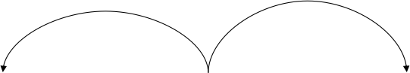
Word2Vec Overview (Skip-gram)
Example windows and process for computing p(w_{t+j}|w_{t})
p(w_{t-2}|w_{t})
p(w_{t+2}|w_{t})
p(w_{t-1}|w_{t})
p(w_{t+1}|w_{t})
…
problems
turning
into
banking
crises
as
…
outside context words in window of size 2
center word at position t
outside context words in window of size 2

Slide 20
Word2Vec Overview (Skip-gram)
Example windows and process for computing p(w_{t+j}|w_{t})
p(w_{t-2}|w_{t})
p(w_{t+2}|w_{t})
p(w_{t-1}|w_{t})
p(w_{t+1}|w_{t})
problems
turning
into
crises
…
intinto o
banking
as
…
banking
outside context words in window of size 2
center word at position t
outside context words in window of size 2

Slide 21
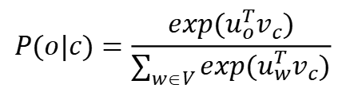
Word2Vec Overview (Skip-gram)
Two matrices, V ∈ R^{n×|V|} and U ∈ R^{|V|×n}.
n is an arbitrary size which defines the size of our embedding space.
V is the input word matrix such that the i-th column of V is the n dimensional embedded vector for word w_{i} when it is an input to this model. We denote this n × 1 vector as v_{i}.
U is the output word matrix. The j-th row of U is an n-dimensional embedded vector for word w_{j} when it is an output of the model. We denote this row of U as u_{j}.
Note that we do in fact learn two vectors for every word w_{i} (i.e. input word vector v_{i} and output word vector u_{i}).
$$P(o|c)=\frac{exp(u_{o}^{T}v_{c})}{\sum_{w∈V}{exp(u_{w}^{T}v_{c})}}$$
Notation for Skip-gram Model:
• w_{i}: Word i from vocabulary V
• V ∈ R^{n×|V|}: Input word matrix
• v_{i}: i-th column of V, the input vector representation of word w_{i}
• U ∈ R^{|V|×n}: Output word matrix
• u_{i}: i-th row of U, the output vector representation of word w_{i}

Slide 22
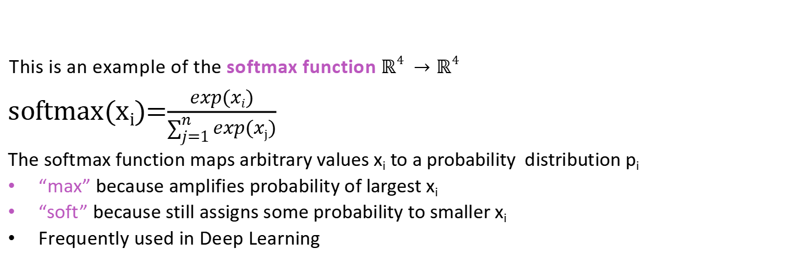
Word2Vec Overview (Skip-gram)
Exponentiation makes anything positive
$$P(o|c)=\frac{exp(u_{o}^{T}v_{c})}{\sum_{w∈V}{exp(u_{w}^{T}v_{c})}}$$
This is an example of the softmax function ℝ⁴ → ℝ⁴
softmax(x_{i})=$\frac{exp(xi)}{\sum_{j=1}^{n}{exp(xj)}}$
The softmax function maps arbitrary values x_{i} to a probability distribution p_{i}
“max” because amplifies probability of largest x_{i}
“soft” because still assigns some probability to smaller x_{i}
Frequently used in Deep Learning

Slide 23
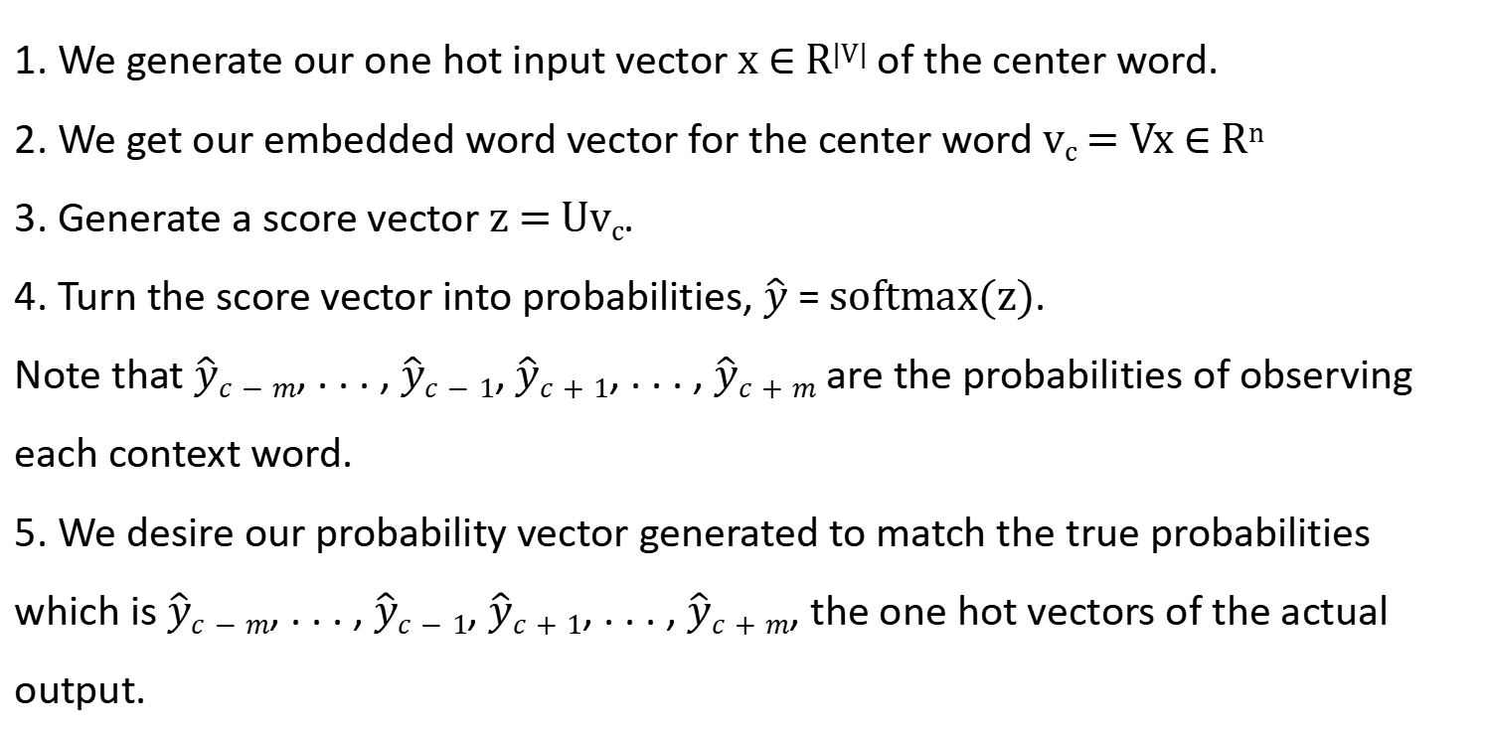
Word2Vec Overview (Skip-gram)
1. We generate our one hot input vector x ∈ R^{|V|} of the center word.
2. We get our embedded word vector for the center word v_{c} = Vx ∈ R^{n}
3. Generate a score vector z = Uv_{c}.
4. Turn the score vector into probabilities, $\hat{y}$ = softmax(z).
Note that $\hat{y}c−m$, . . . , $\hat{y}c−1$, $\hat{y}c+1$, . . . , $\hat{y}c+m$ are the probabilities of observing each context word.
5. We desire our probability vector generated to match the true probabilities which is $\hat{y}c−m$, . . . , $\hat{y}c−1$, $\hat{y}c+1$, . . . , $\hat{y}c+m$, the one hot vectors of the actual output.

Slide 24
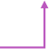
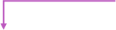
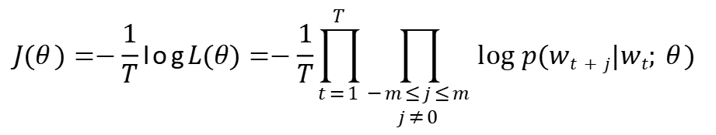
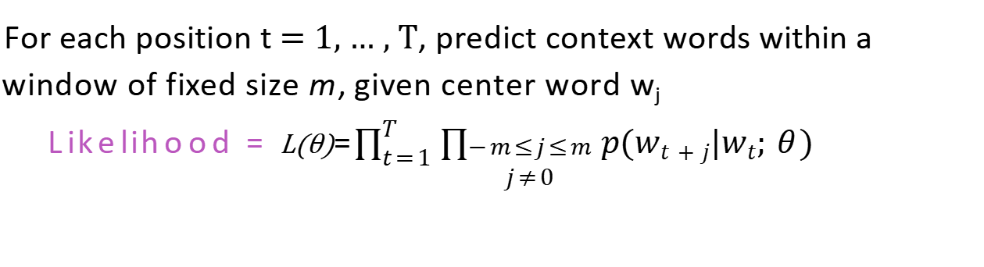
Word2Vec Overview (Skip-gram)
For each position t = 1, … , T, predict context words within a window of fixed size m, given center word w_{j}
Likelihood = L(θ)=$\prod_{t=1}^{T}{\prod_{\begin{aligned}−m≤j≤m \\ j≠0\end{aligned}}{p(wt+j|wt; θ) }}$
θ is all variables to be optimized
sometimes called cost or loss function
The objective function is the (average) negative log likelihood:
$$J(θ)=−\frac{1}{T}logL(θ)=−\frac{1}{T}\prod_{t=1}^{T}{\prod_{\begin{aligned}−m≤j≤m \\ j≠0\end{aligned}}{log p(wt+j|wt; θ) }}$$

Slide 25
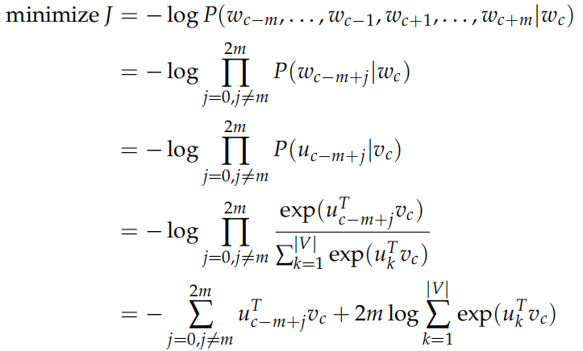
Word2Vec Overview (Skip-gram)
Objective function: A key difference here is that we invoke a Naive Bayes assumption to break out the probabilities.
In other words, given the center word, all output words are completely independent.

Slide 26
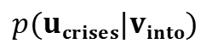
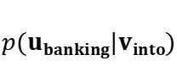
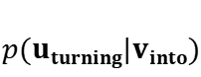
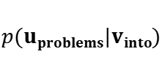
Word2Vec Overview (Skip-gram)
Example windows and process for computing$p(wt+j|wt)$
$p(uproblems|vinto$) short for $p(problems|into ;uproblems,vinto$, $θ$)
$p(uproblems|vinto$)
$p(uturning|vinto$)
$p(ubanking|vinto$)
$p(ucrises|vinto$)
…
problems
turning
into
banking
crises
as
…
outside context words in window of size 2
center word at position t
outside context words in window of size 2

Slide 27
Word2Vec Overview (CBOW)
Treat {"problems", "turning", “banking”, “crises”} as a context and from these words
Predict or generate the center word "into".
This type of model we call a Continuous Bag of Words (CBOW) Model.
…
problems
turning
into
banking
crises
as
…
outside context words in window of size 2
center word at position t
outside context words in window of size 2

Slide 28
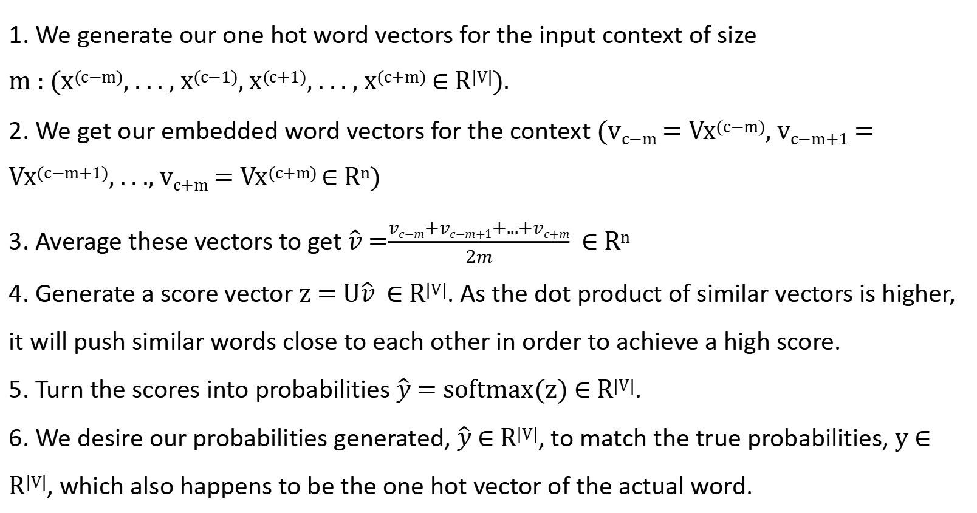
Word2Vec Overview (CBOW)
1. We generate our one hot word vectors for the input context of size
m : (x^{(c−m)}, . . . , x^{(c−1)}, x^{(c+1)}, . . . , x^{(c+m)} ∈ R^{|V|}).
2. We get our embedded word vectors for the context (v_{c−m} = Vx^{(c−m)}, v_{c−m+1} = Vx^{(c−m+1)}, . . ., v_{c+m} = Vx^{(c+m)} ∈ R^{n})
3. Average these vectors to get $\hat{v}$ =$\frac{vc−m+vc−m+1+...+vc+m}{2m}$ ∈ R^{n}
4. Generate a score vector z = U$\hat{v}$ ∈ R^{|V|}. As the dot product of similar vectors is higher, it will push similar words close to each other in order to achieve a high score.
5. Turn the scores into probabilities $\hat{y}$ = softmax(z) ∈ R^{|V|}.
6. We desire our probabilities generated, $\hat{y}$ ∈ R^{|V|}, to match the true probabilities, y ∈ R^{|V|}, which also happens to be the one hot vector of the actual word.

Slide 29
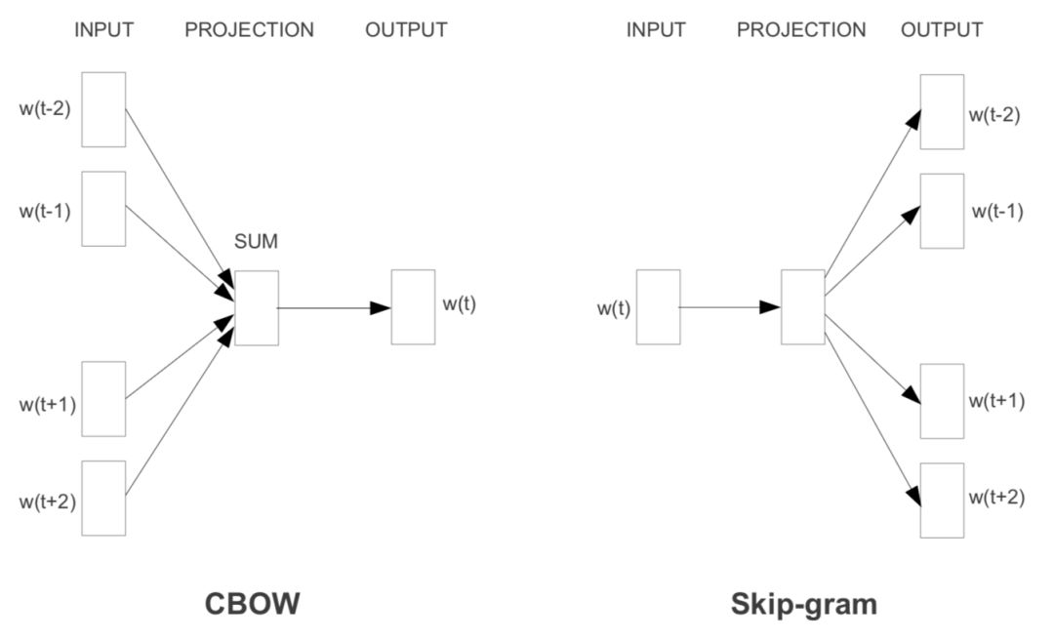
CBOW v.s. Skip-gram

Slide 30
Word2vec: More details
Additional efficiency in training:
1. Negative sampling
2. Hierarchical Softmax

Slide 31
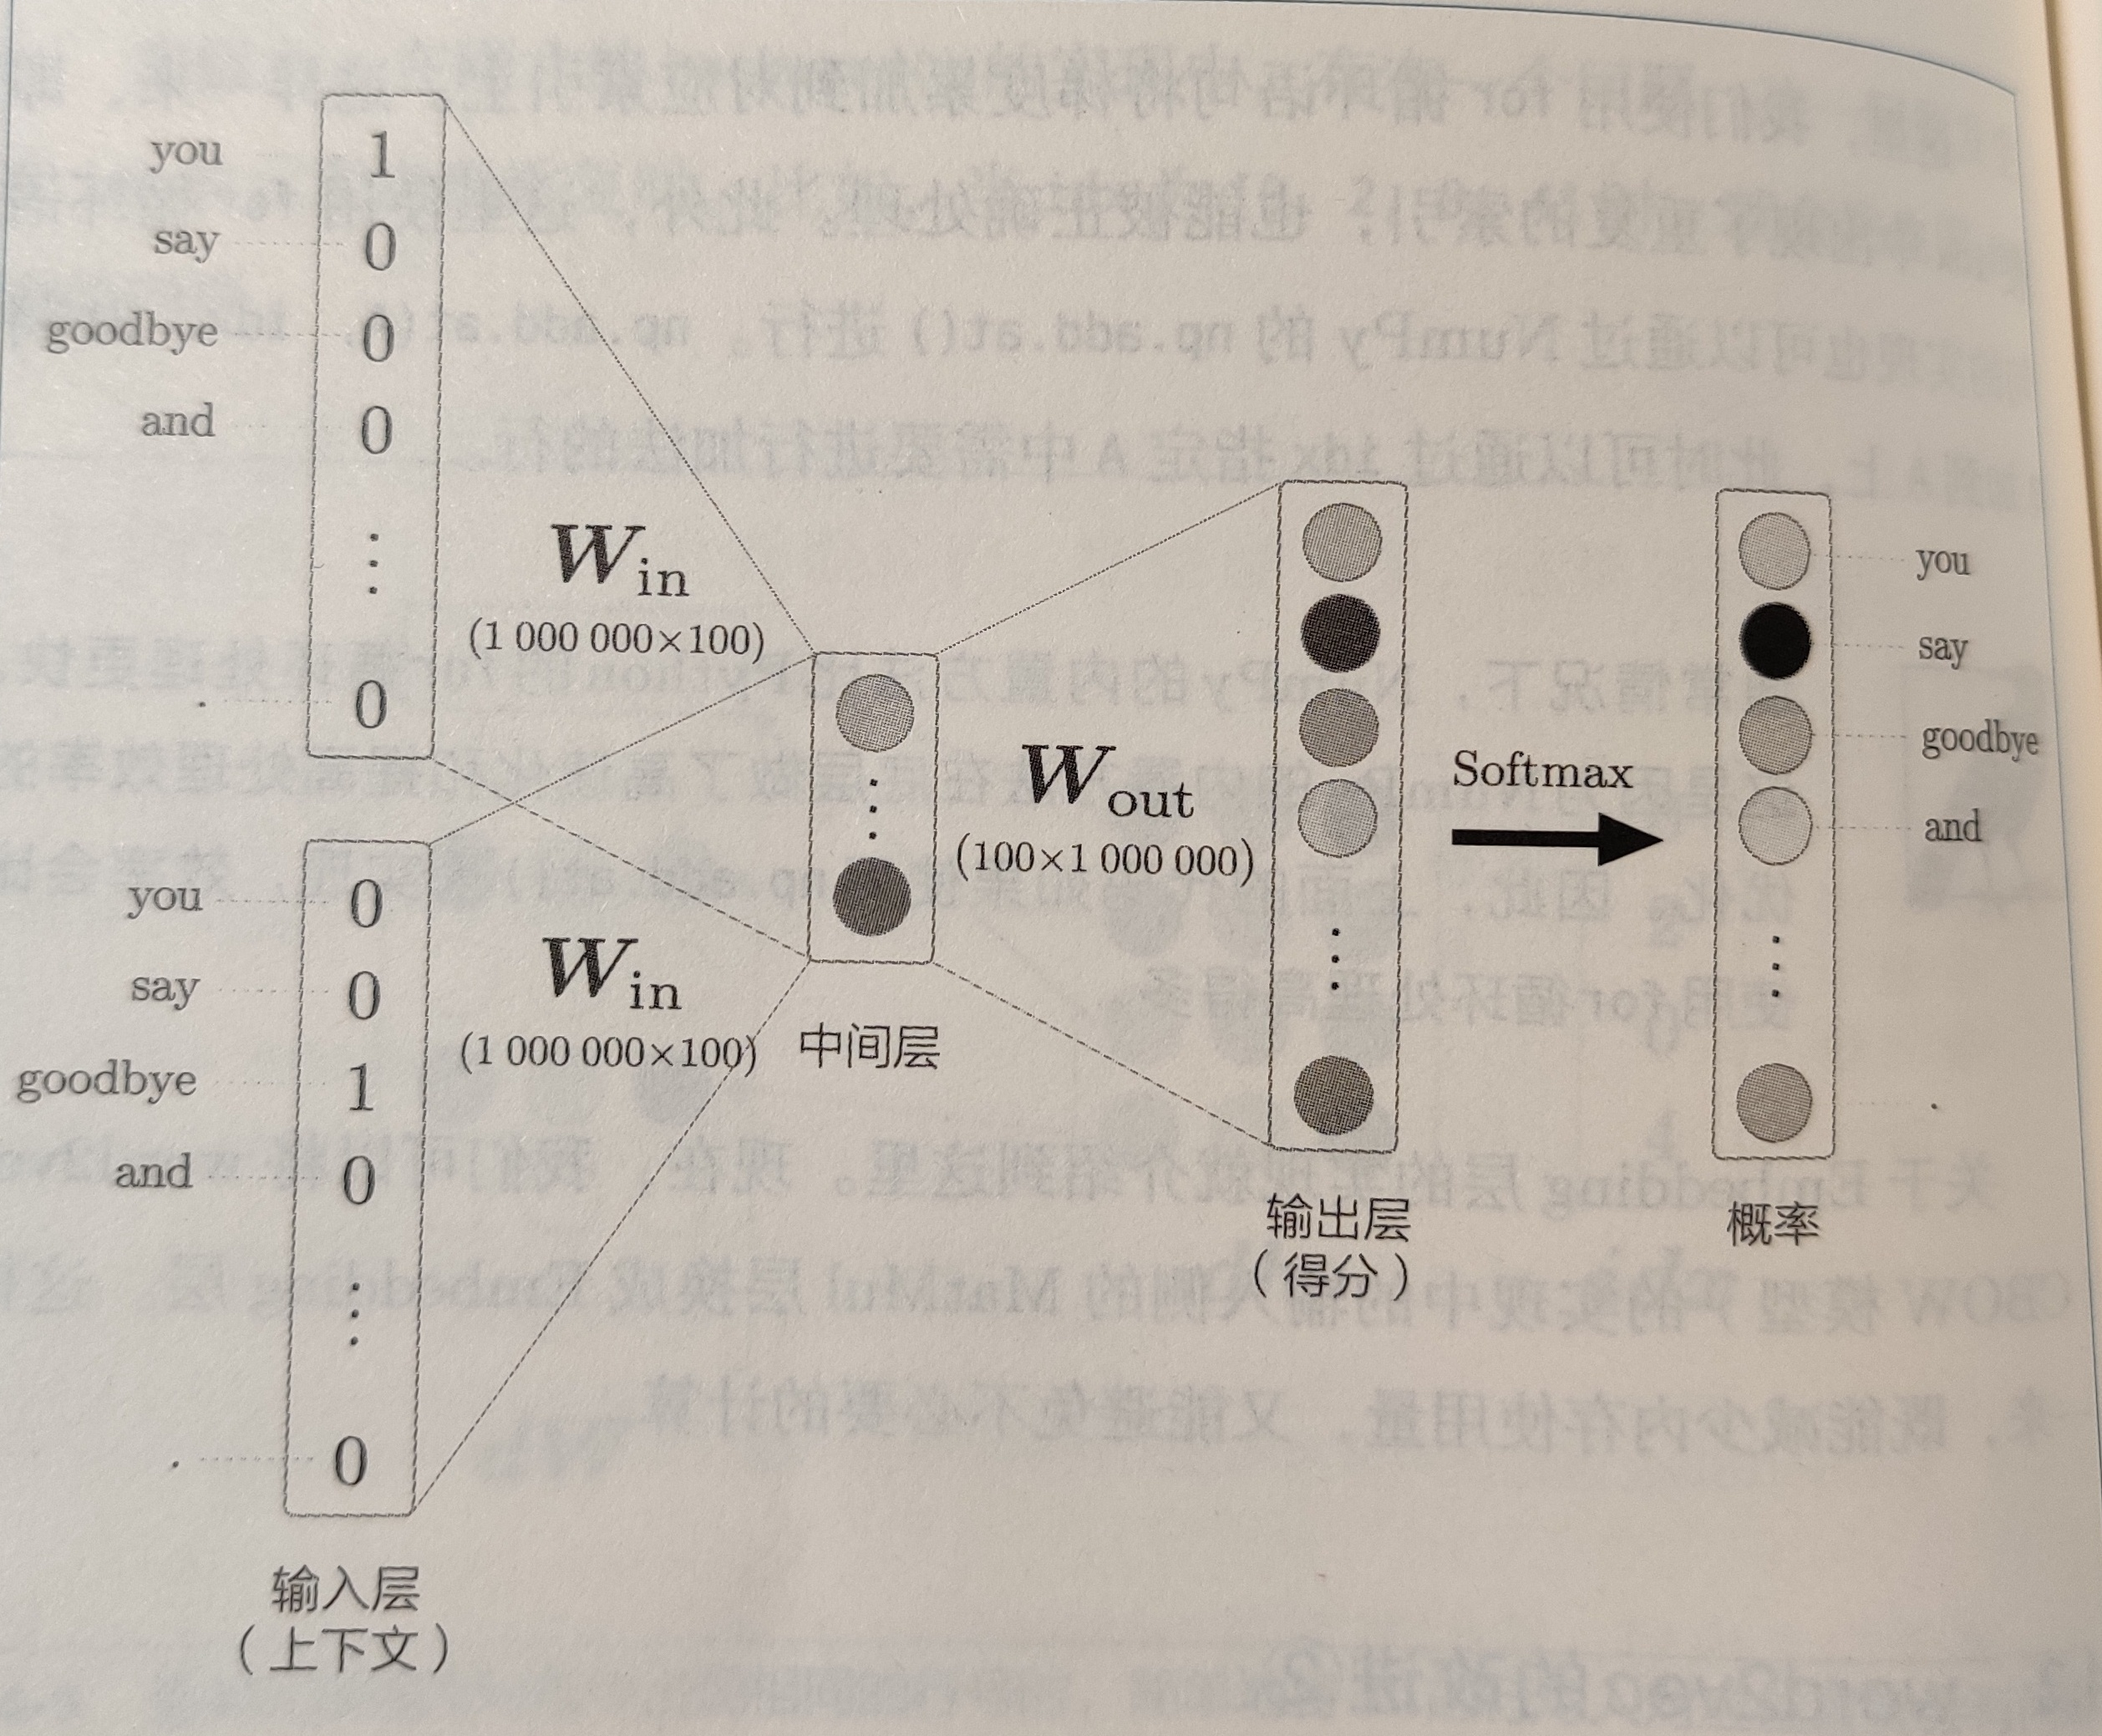
Word2vec: Negative sampling
Problem: softmax is computational.
For every training step, instead of looping over the entire vocabulary, we can just sample several negative examples!
We "sample" from a noise distribution (P_{n}(w)) whose probabilities match the ordering of the frequency of the vocabulary.

Slide 32
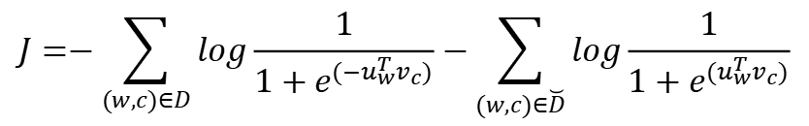
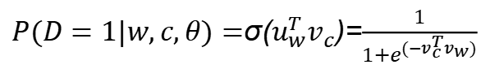
Word2vec: Negative sampling
Consider a pair (w, c) of word and context.
P(D = 1|w, c): the probability that (w, c) came from the corpus data.
P(D = 0|w, c): the probability that (w, c) did not come from the corpus data.
Model P(D = 1|w, c) with the sigmoid function:
$P(D=1|w,c,θ)=$σ($u_{w}^{T}v_{c}$)=$\frac{1}{1+e^{(−v_{c}^{T}v_{w})}}$
Build a new objective function that tries to:
maximize the probability of a word and context being in the corpus data if it indeed is
maximize the probability of a word and context not being in the corpus data if it indeed is not.
θ=argmax $\prod_{(w,c)∈D}{P(D=1|w,c,θ)}\prod_{(w,c)∈\breve{D}}{P(D=0|w,c,θ)}$
$$J=−\sum_{(w,c)∈D}{log\frac{1}{1+e^{(−u_{w}^{T}v_{c})}}−\sum_{(w,c)∈\breve{D}}{log\frac{1}{1+e^{(u_{w}^{T}v_{c})}}}}$$

Slide 33
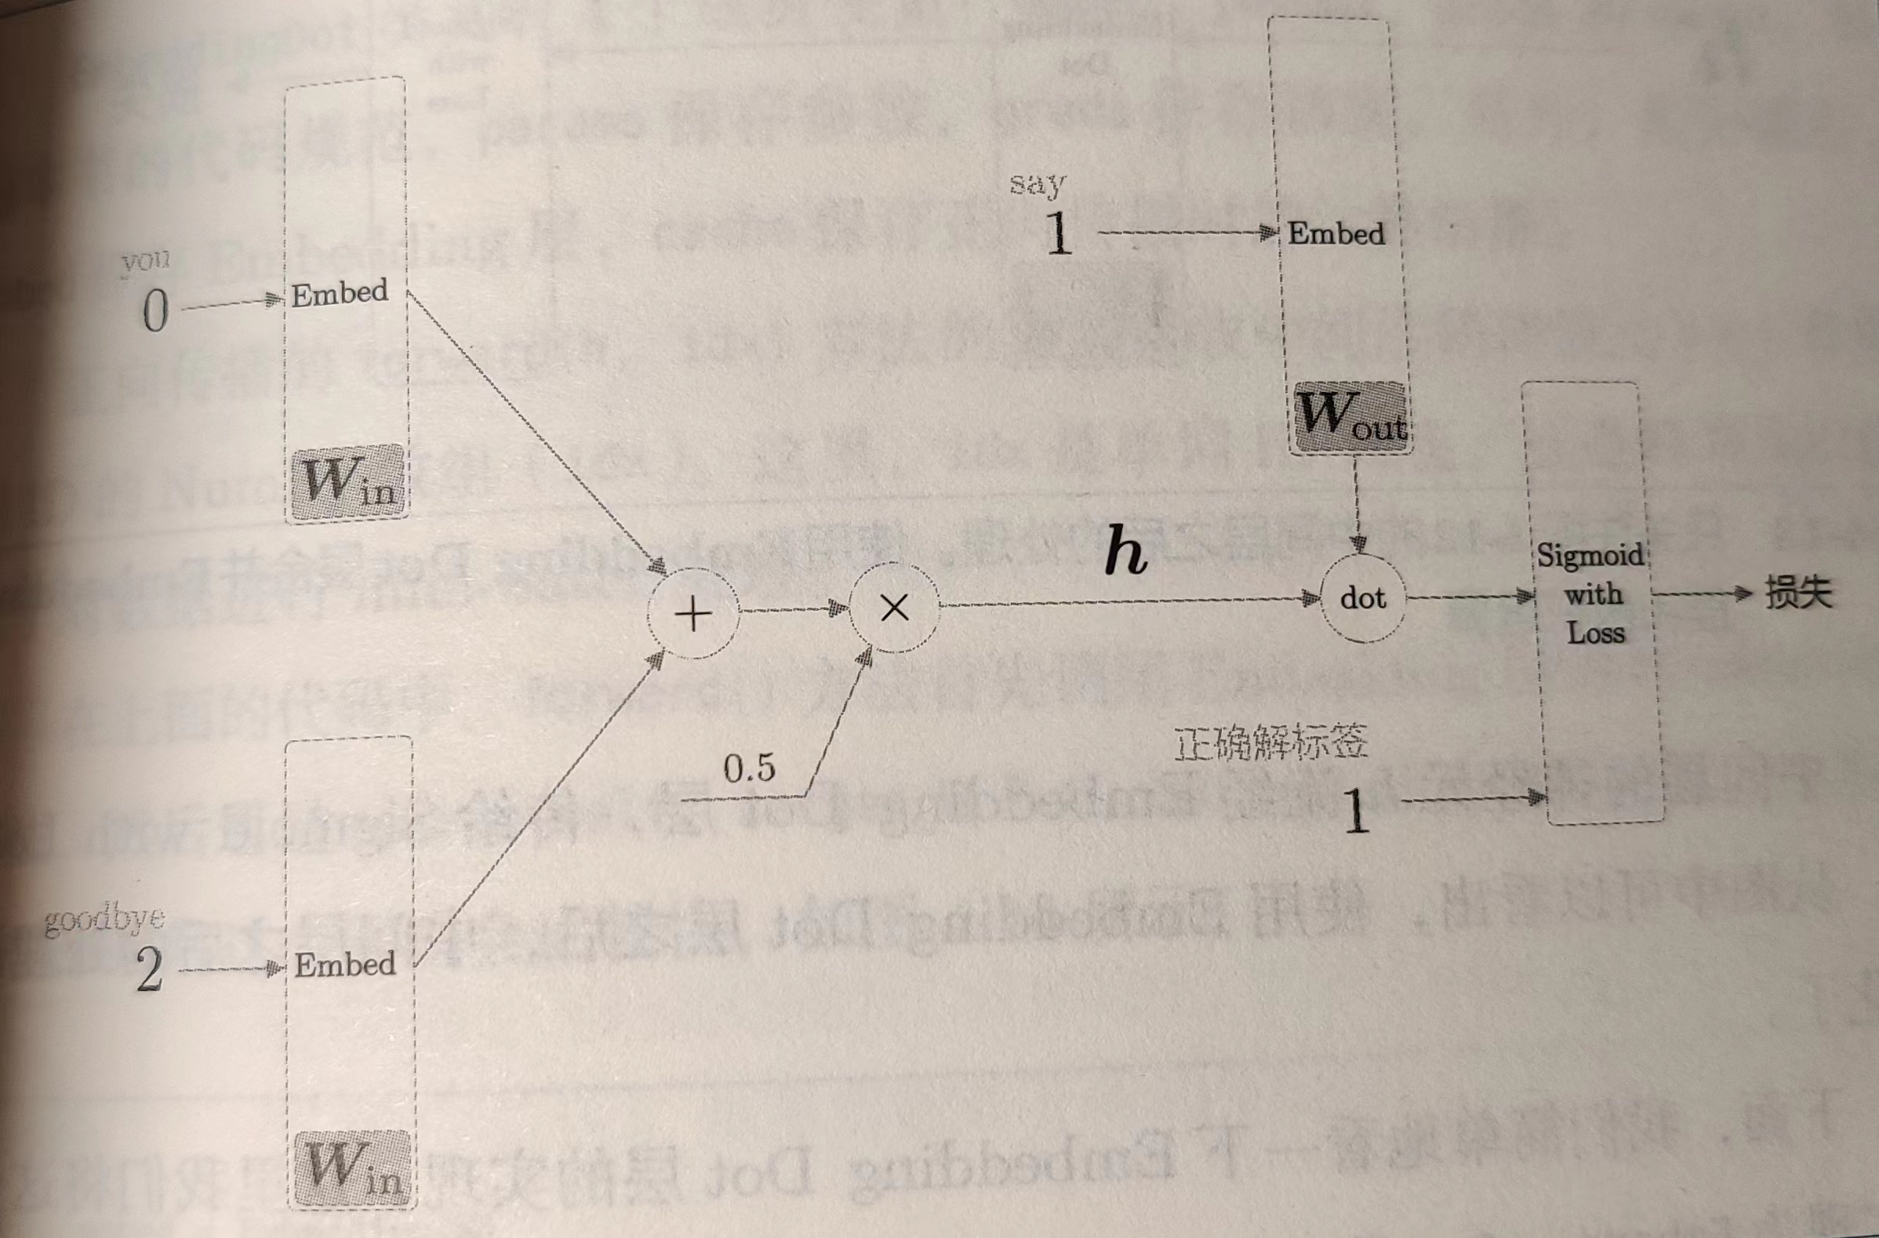

Slide 34
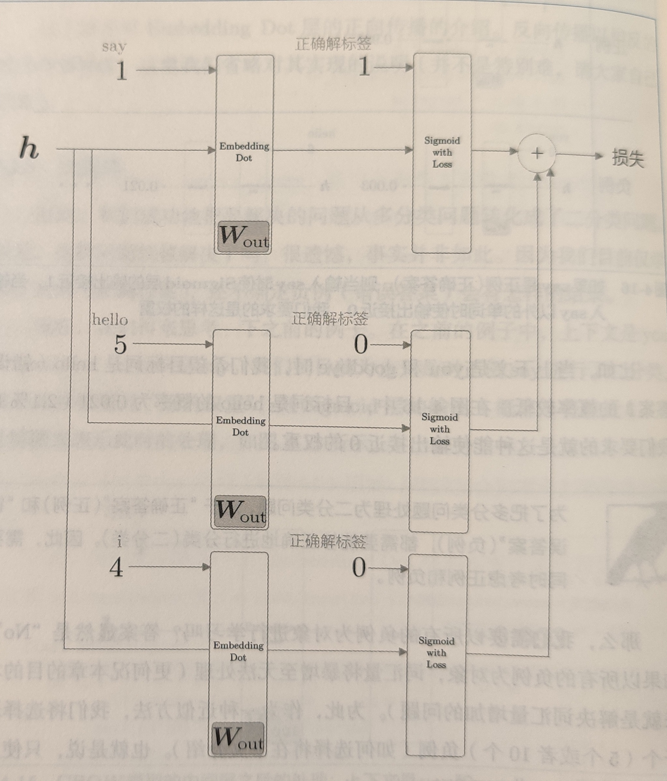

Slide 35
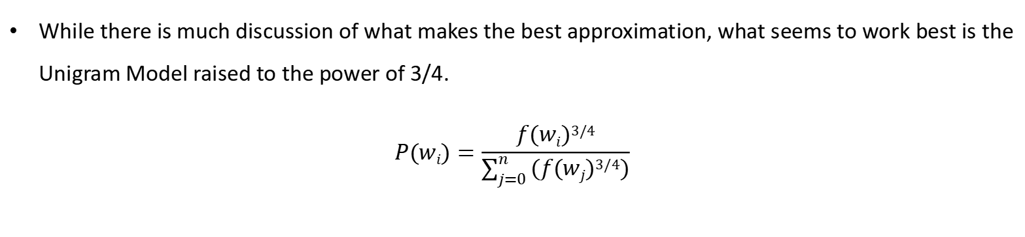
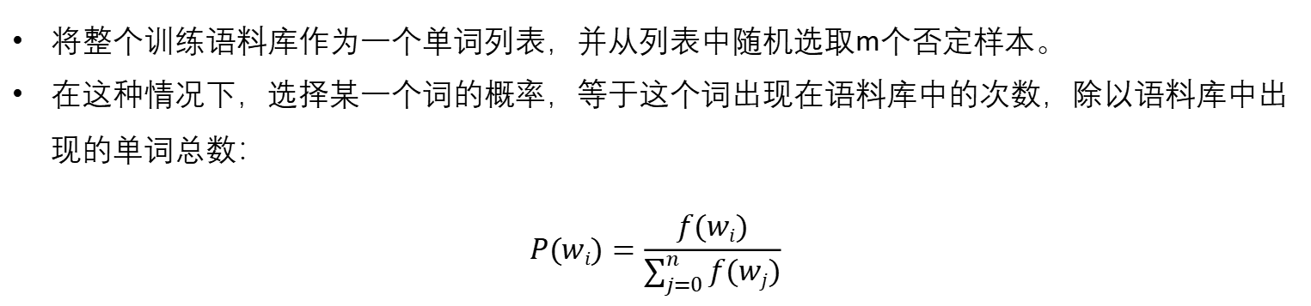
Word2vec: Negative sampling
将整个训练语料库作为一个单词列表，并从列表中随机选取m个否定样本。
在这种情况下，选择某一个词的概率，等于这个词出现在语料库中的次数，除以语料库中出现的单词总数：
$$P(wi)=\frac{f(wi)}{\sum_{j=0}^{n}{f(wj)}}$$
While there is much discussion of what makes the best approximation, what seems to work best is the Unigram Model raised to the power of 3/4.
$$P(wi)=\frac{f(wi)3/4}{\sum_{j=0}^{n}{(f(wj)3/4)}}$$

Slide 36
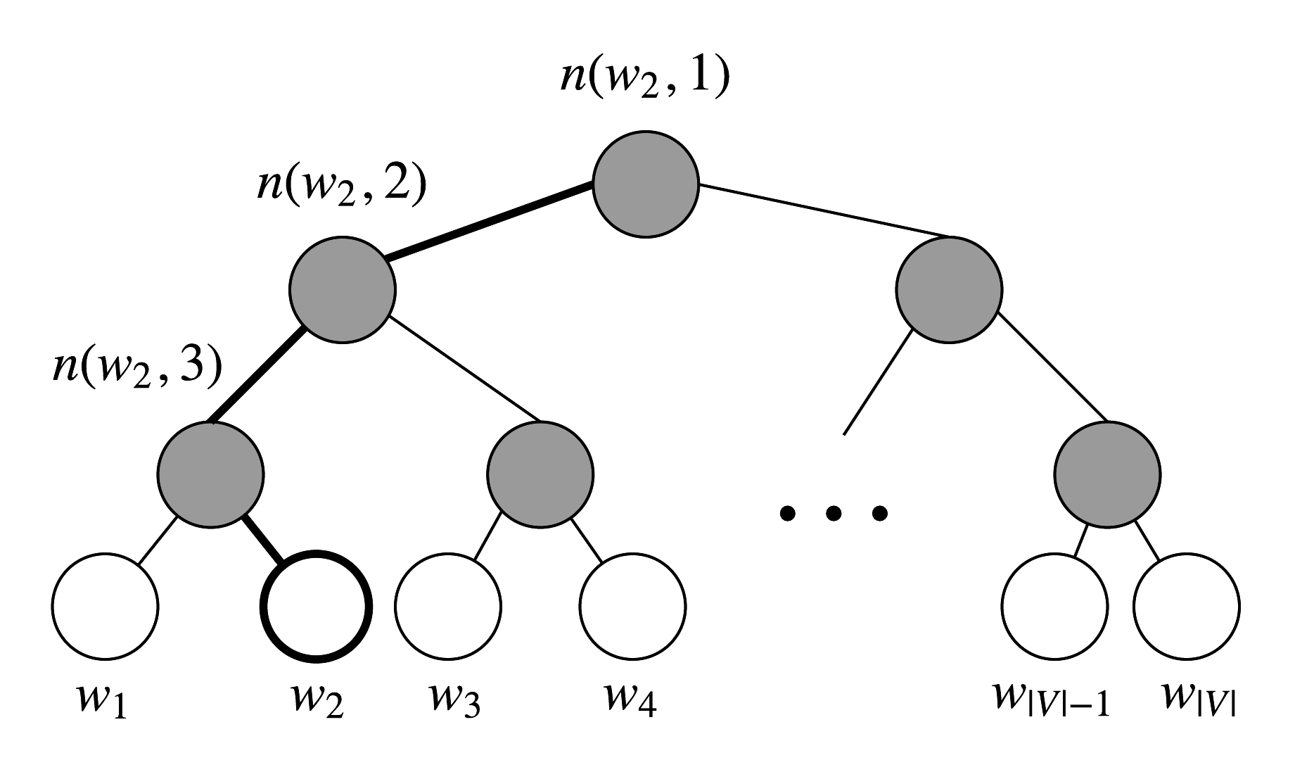
Word2vec: Hierarchical Softmax
Hierarchical softmax uses a binary tree to represent all words in the vocabulary. Each leaf of the tree is a word, and there is a unique path from root to leaf.
In this model, there is no output representation for words.
Instead, each node of the graph (except the root and the leaves) is associated to a vector that the model is going to learn.

Slide 37
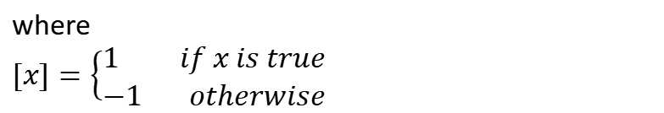
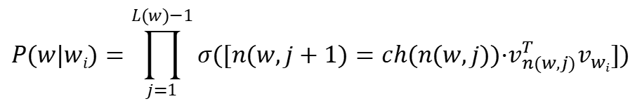
Word2vec: Hierarchical Softmax
Let L(w) be the number of nodes in the path from the root to the leaf w , i.e. L(w₂) is 3.
Let’s write n(w, i) as the i-th node on this path with associated vector v_{n(w,i)}.
n(w, 1) is the root, while n(w, L(w)) is the father of w.
For each inner node n, we arbitrarily choose one of its children and call it ch(n) (e.g. always the left node).
$$P(w|wi)=\prod_{j=1}^{L(w)−1}{σ([n(w,j+1)=ch(n(w,j))·v_{n(w,j)}^{T}v_{wi}])}$$
where
$[x]=\left\{\begin{aligned}1 if x is true \\ −1 otherwise\end{aligned}\right.$

Slide 38
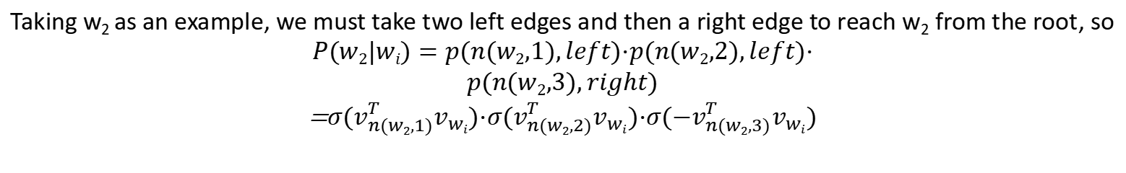
Word2vec: Hierarchical Softmax
Taking w₂ as an example, we must take two left edges and then a right edge to reach w₂ from the root, so
$$P(w2|wi)=p(n(w2,1),left)·p(n(w2,2),left)·$$
$$p(n(w2,3),right)$$
=$σ(v_{n(w2,1)}^{T}v_{wi})·σ(v_{n(w2,2)}^{T}v_{wi})·σ({−v}_{n(w2,3)}^{T}v_{wi})$
Instead of updating output vectors per word, we update the vectors of the nodes in the binary tree that are in the path from root to leaf node
层次化softmax的目标函数就是最大化目标词的路径概率，只需要关注目标词的路径概率即可，而目标词是已知的，完全不需要计算其他的词的路径概率。

Slide 39
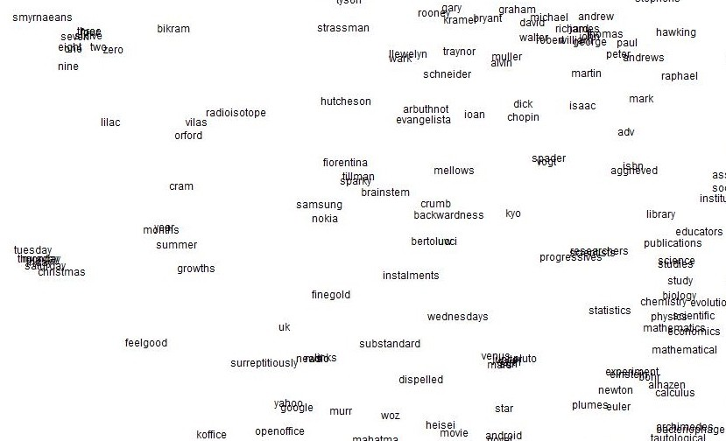
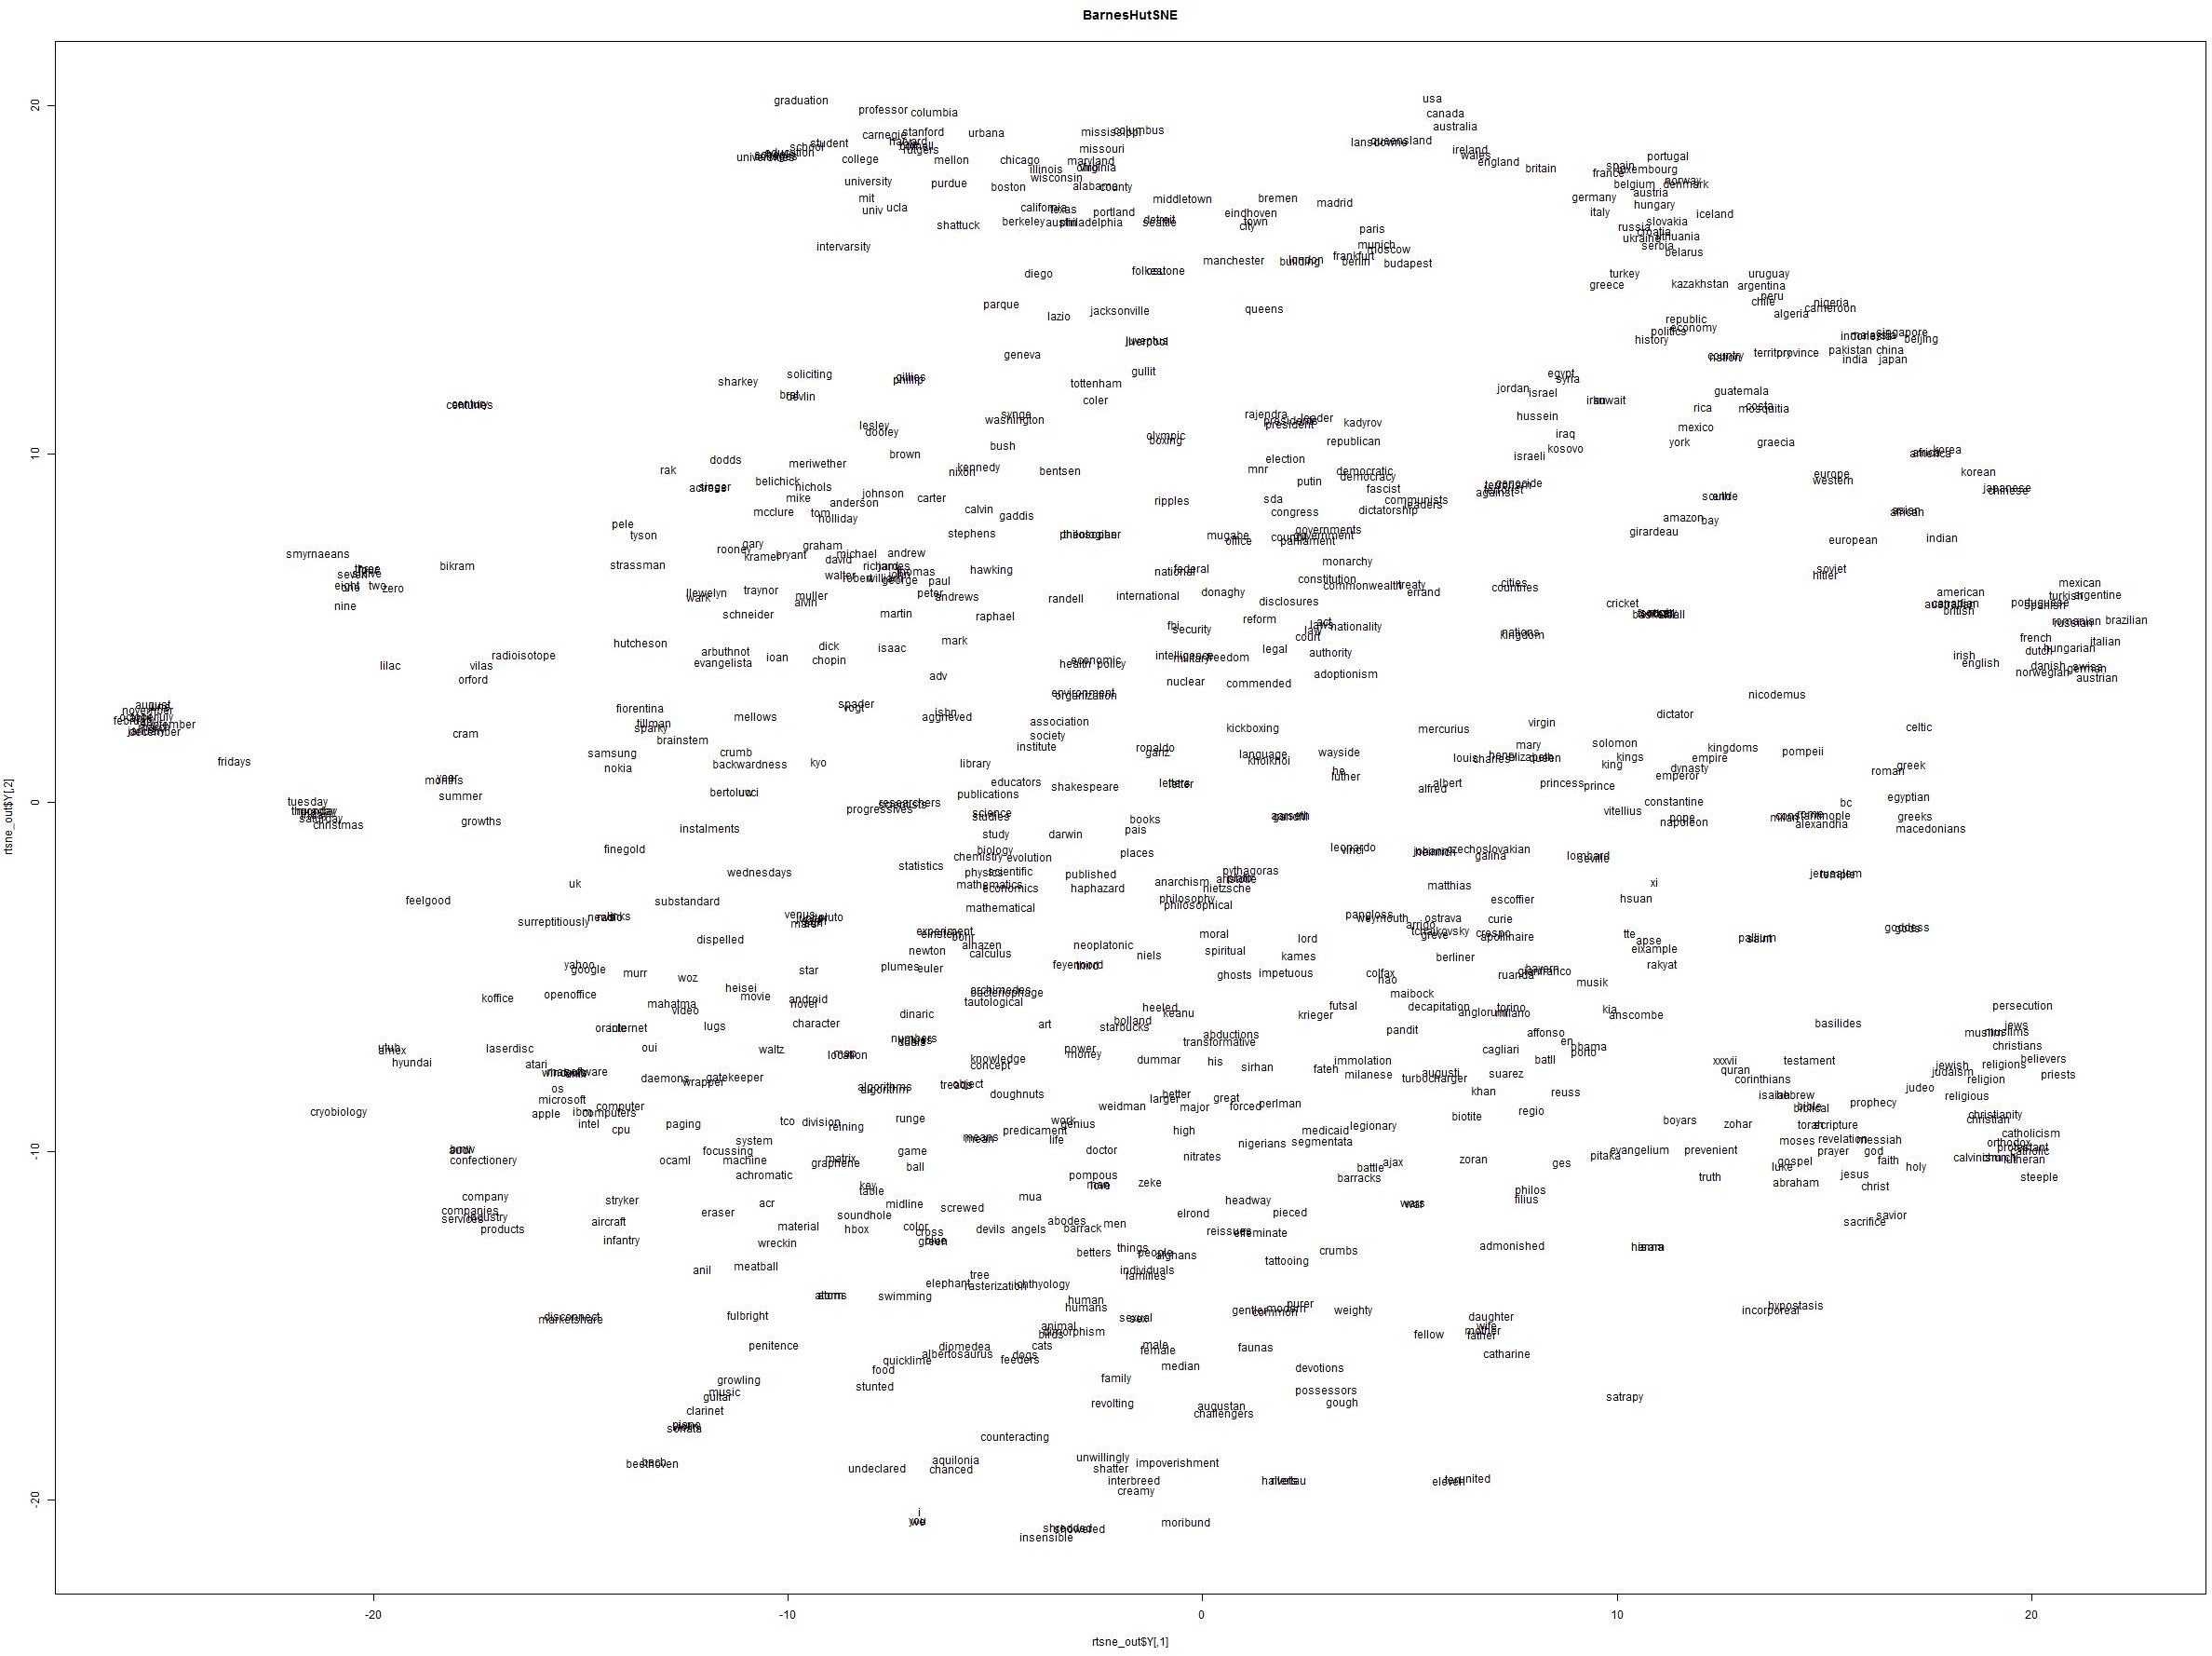
Word2vec maximizes objective function by putting similar words nearby in space

Slide 40
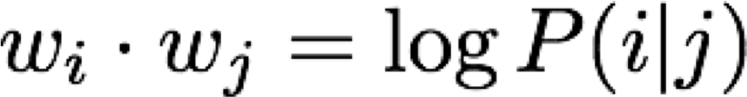
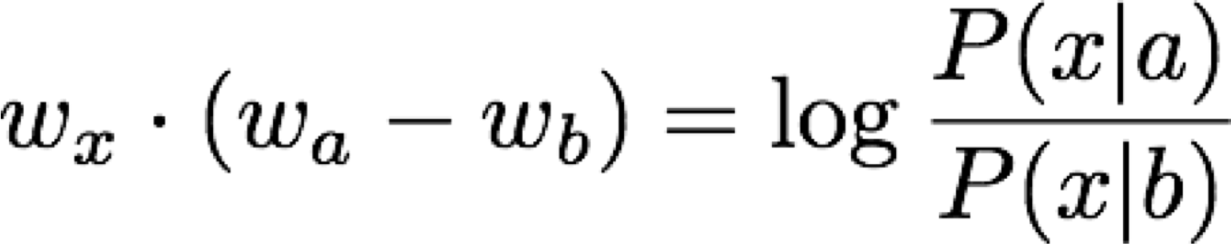
Encoding meaning in vector differences
Q: How can we capture ratios of co-occurrence probabilities as linear meaning components in a word vector space?
A:
Log-bilinear model: with vector differences

Slide 41
Window based co-occurrence matrix
Window length 1 (more common: 5–10)
Symmetric (irrelevant whether left or right context)
Example corpus:
I like deep learning.
I like NLP.
I enjoy flying.
perform SVD on X(co-occurence matrix), observe the singular values (the diagonal entries in the resulting S matrix), and cut them off at some index k-based on the desired percentage variance captured

Slide 42
Window based co-occurrence matrix
Example corpus:
I like deep learning.
I like NLP.
I enjoy flying.
counts | I | like | enjoy | deep | learning | NLP | flying | .
I | 0 | 2 | 1 | 0 | 0 | 0 | 0 | 0
like | 2 | 0 | 0 | 1 | 0 | 1 | 0 | 0
enjoy | 1 | 0 | 0 | 0 | 0 | 0 | 1 | 0
deep | 0 | 1 | 0 | 0 | 1 | 0 | 0 | 0
learning | 0 | 0 | 0 | 1 | 0 | 0 | 0 | 1
NLP | 0 | 1 | 0 | 0 | 0 | 0 | 0 | 1
flying | 0 | 0 | 1 | 0 | 0 | 0 | 0 | 1
. | 0 | 0 | 0 | 0 | 1 | 1 | 1 | 0

Slide 43
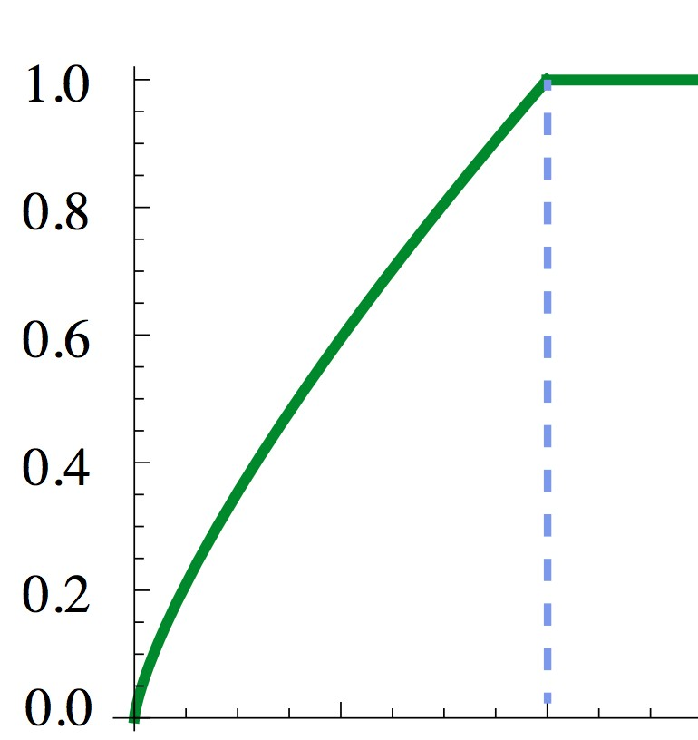
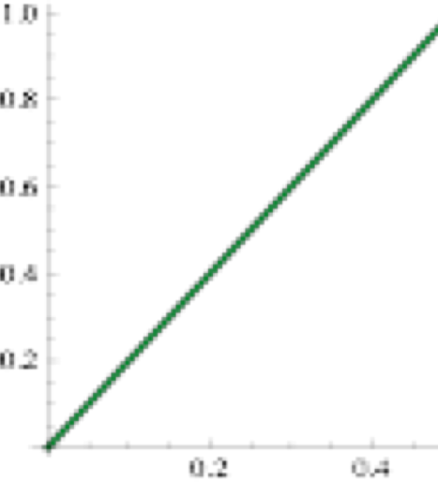
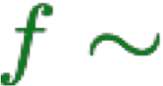
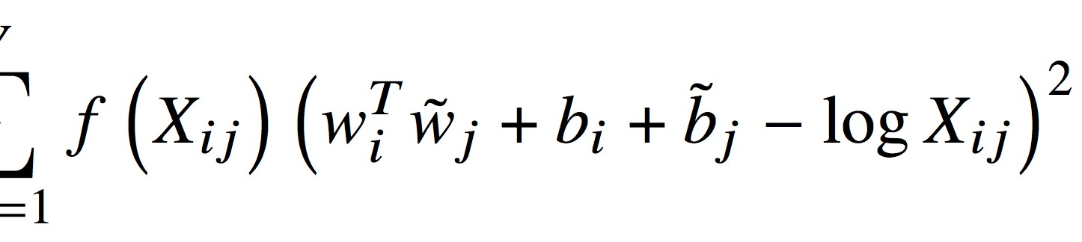
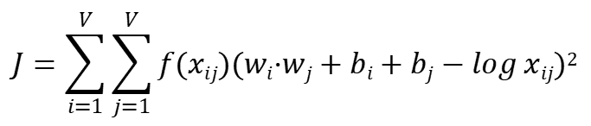
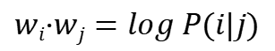
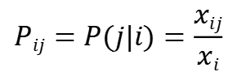
Combining the best of both worlds GloVe [Pennington et al., EMNLP 2014]
$$Pij=P(j|i)=\frac{xij}{xi}$$
$$wi·wj=log P(i|j)$$
$$J=\sum_{i=1}^{V}{\sum_{j=1}^{V}{f(xij)(wi·wj+bi+bj−log xij)2}}$$
Fast training
Scalable to huge corpus
Good performance even with small corpus and small vectors

Slide 44
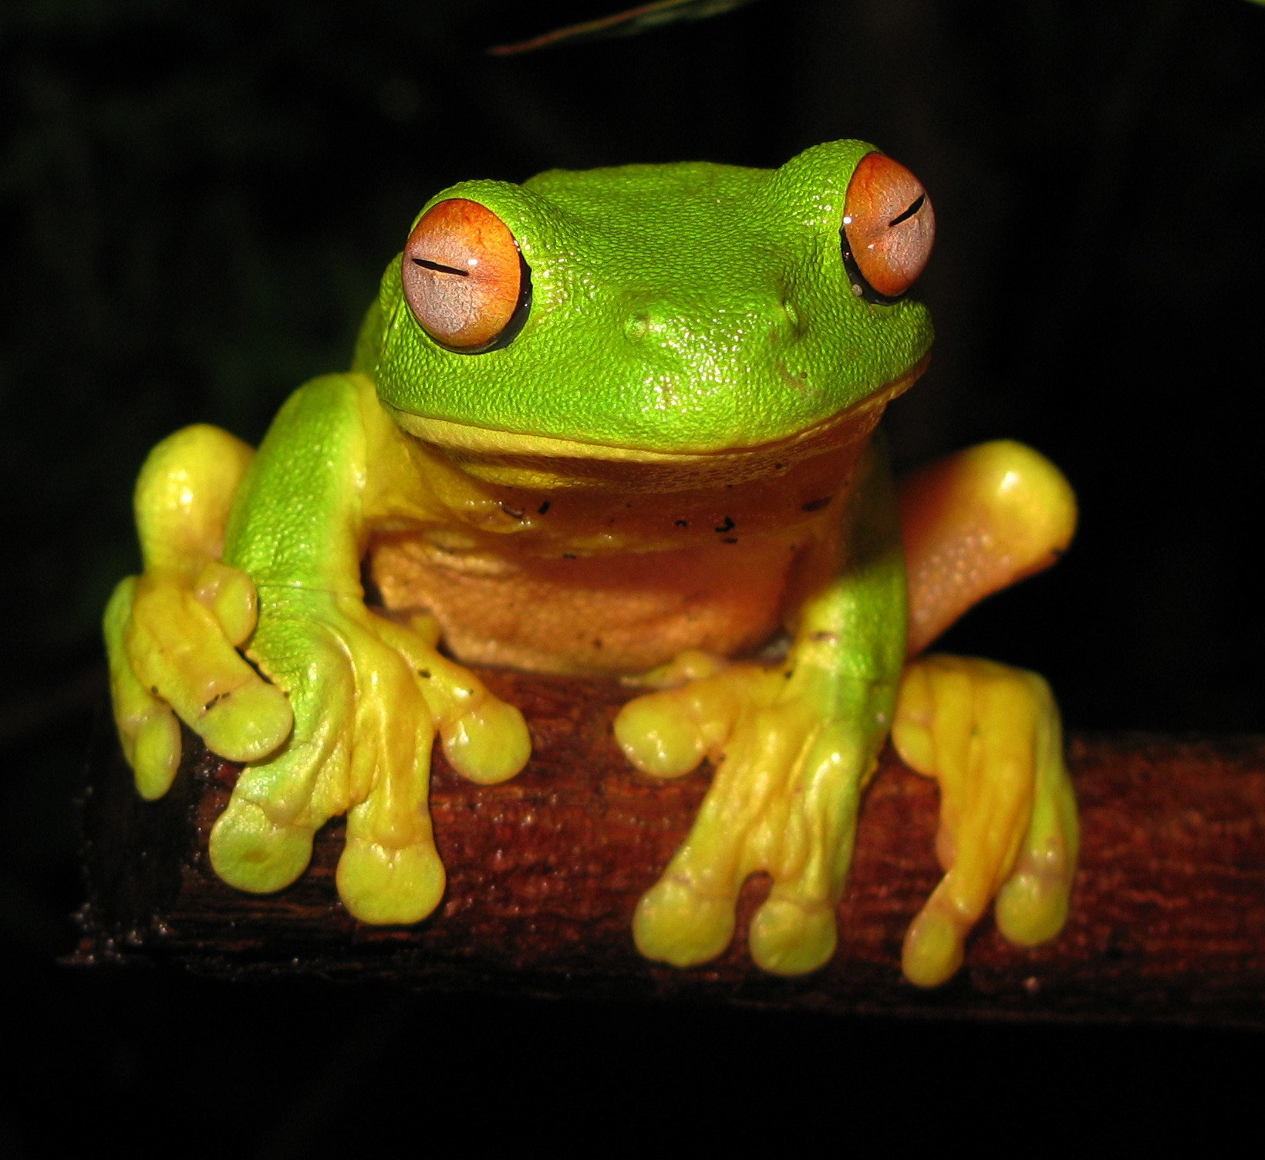
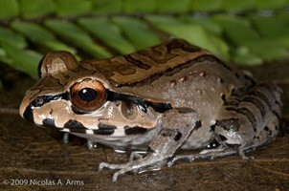
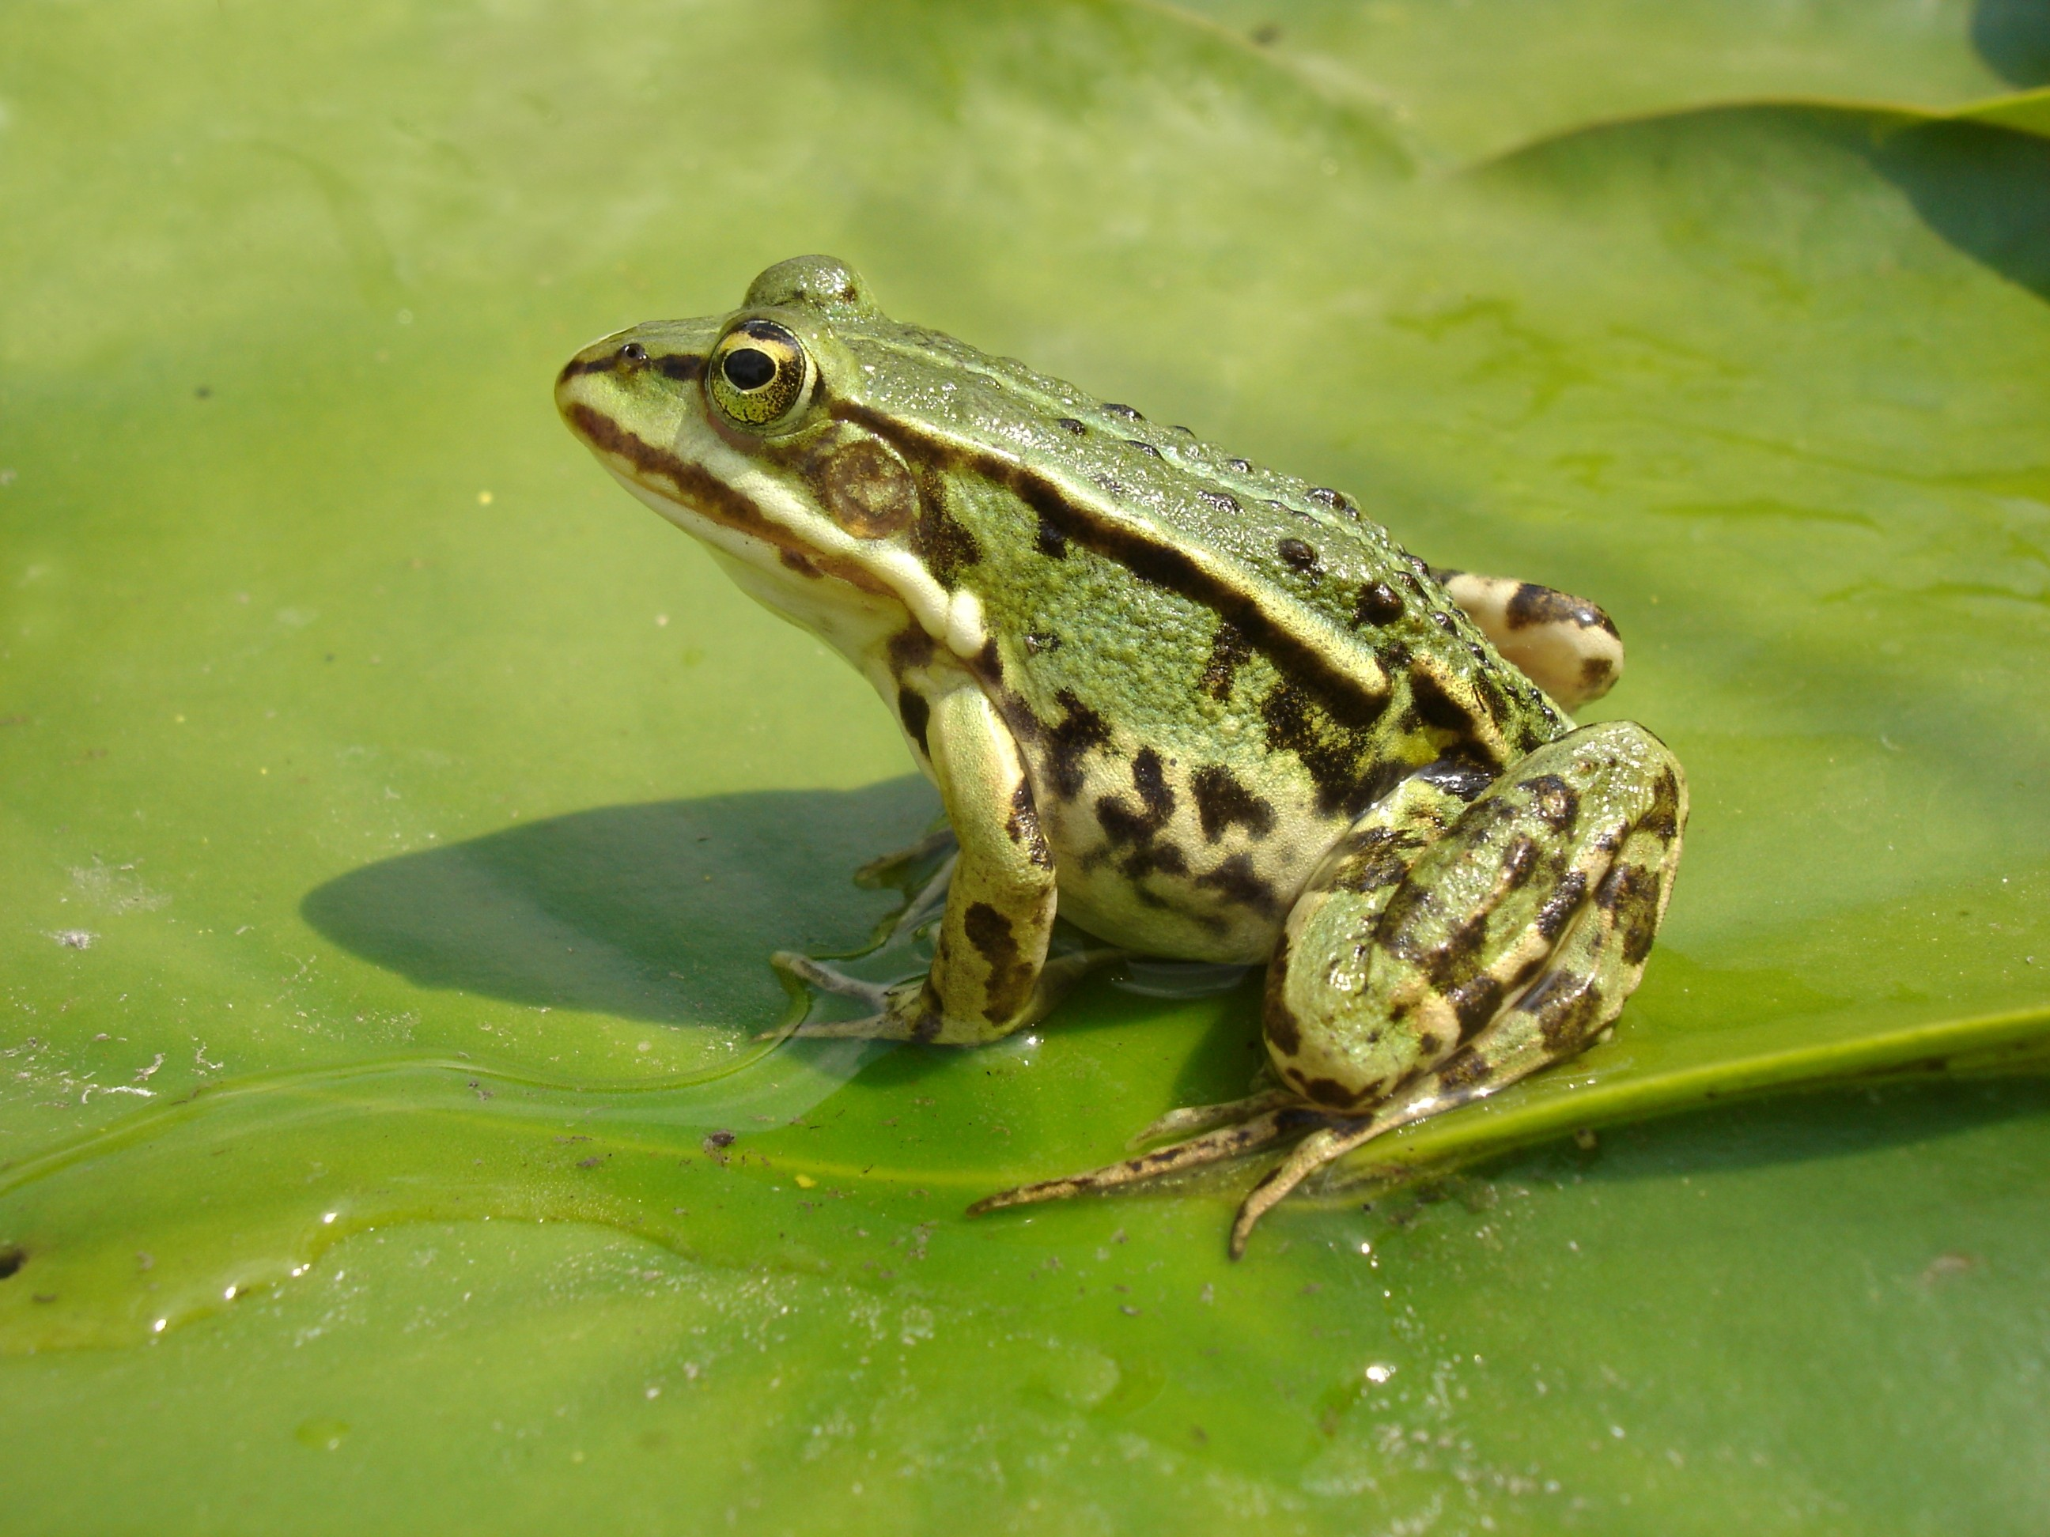
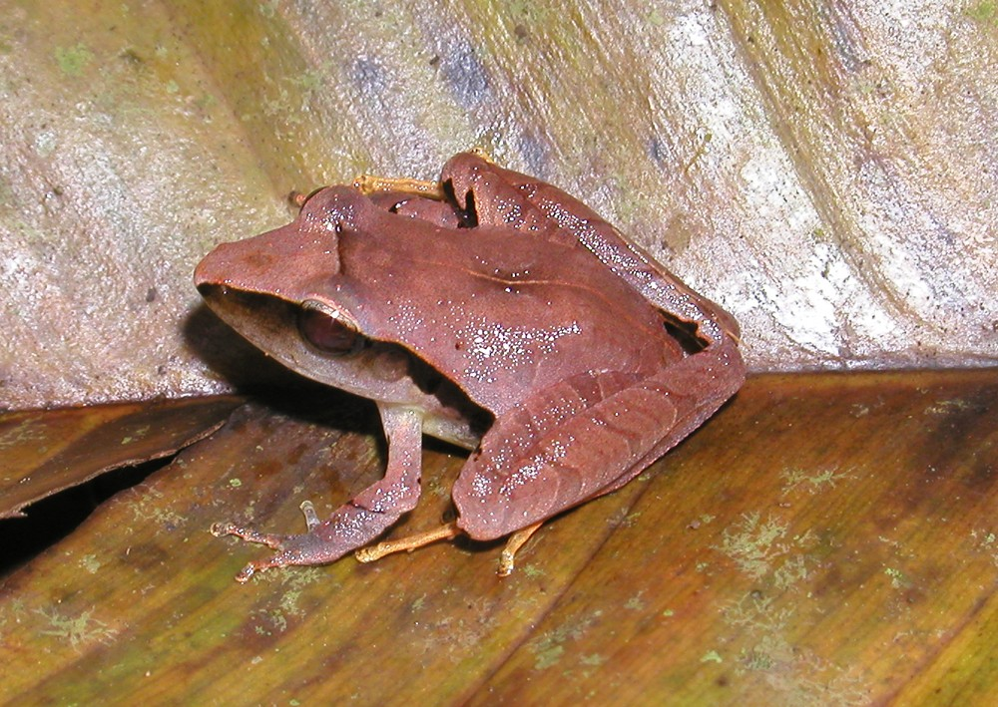
GloVe results
Nearest words to frog:
frogs
toad
litoria
leptodactylidae
rana
lizard
eleutherodactylus
litoria
leptodactylidae
rana
eleutherodactylus

Slide 45
How to evaluate word vectors?
Related to general evaluation in NLP: Intrinsic vs extrinsic
Intrinsic:
Evaluation on a specific/intermediate subtask
Fast to compute
Helps to understand that system
Not clear if really helpful unless correlation to real task is established
Extrinsic:
Evaluation on a real task
Can take a long time to compute accuracy
Unclear if the subsystem is the problem or its interaction or other subsystems
If replacing exactly one subsystem with another improves accuracy →
Winning!

Slide 46
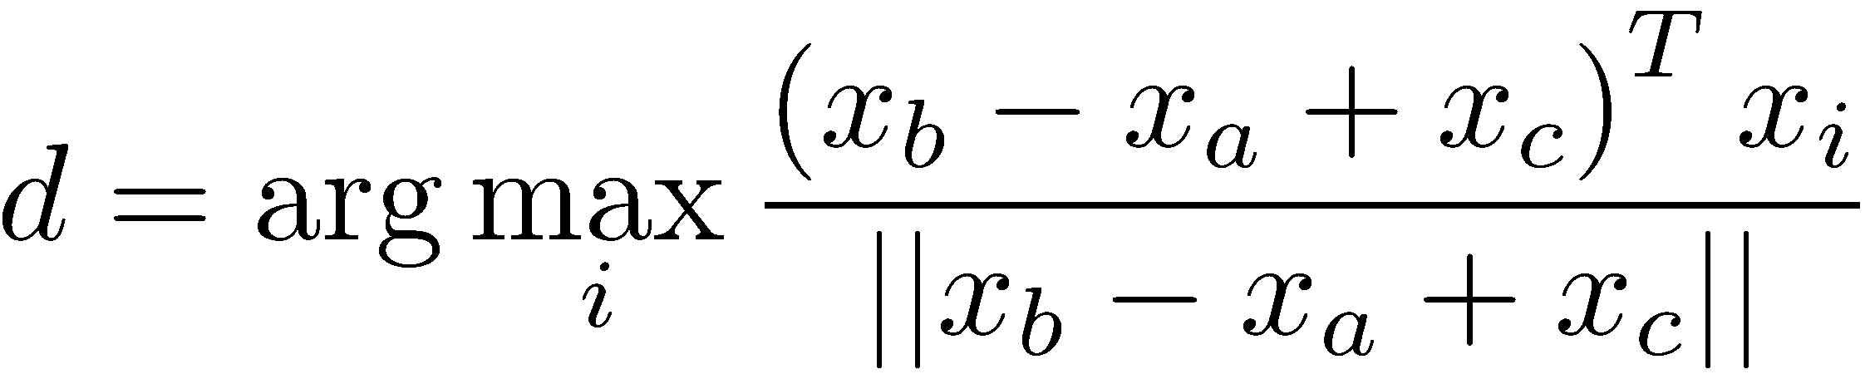
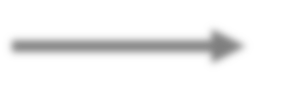
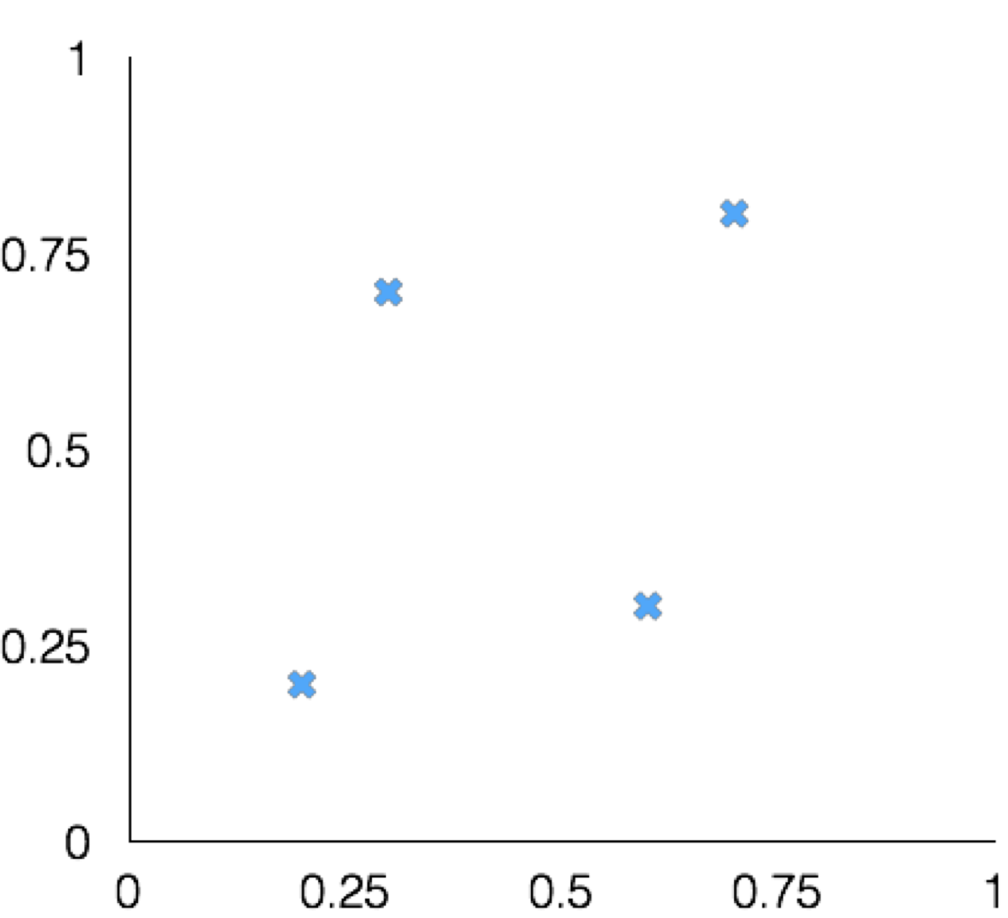
Intrinsic word vector evaluation
Word Vector Analogies
a:b :: c:?
man:woman :: king:?
Evaluate word vectors by how well their cosine distance after addition captures intuitive semantic and syntactic analogy questions
Discarding the input words from the search!
Problem: What if the information is there but not linear?
king
woman
man

Slide 47
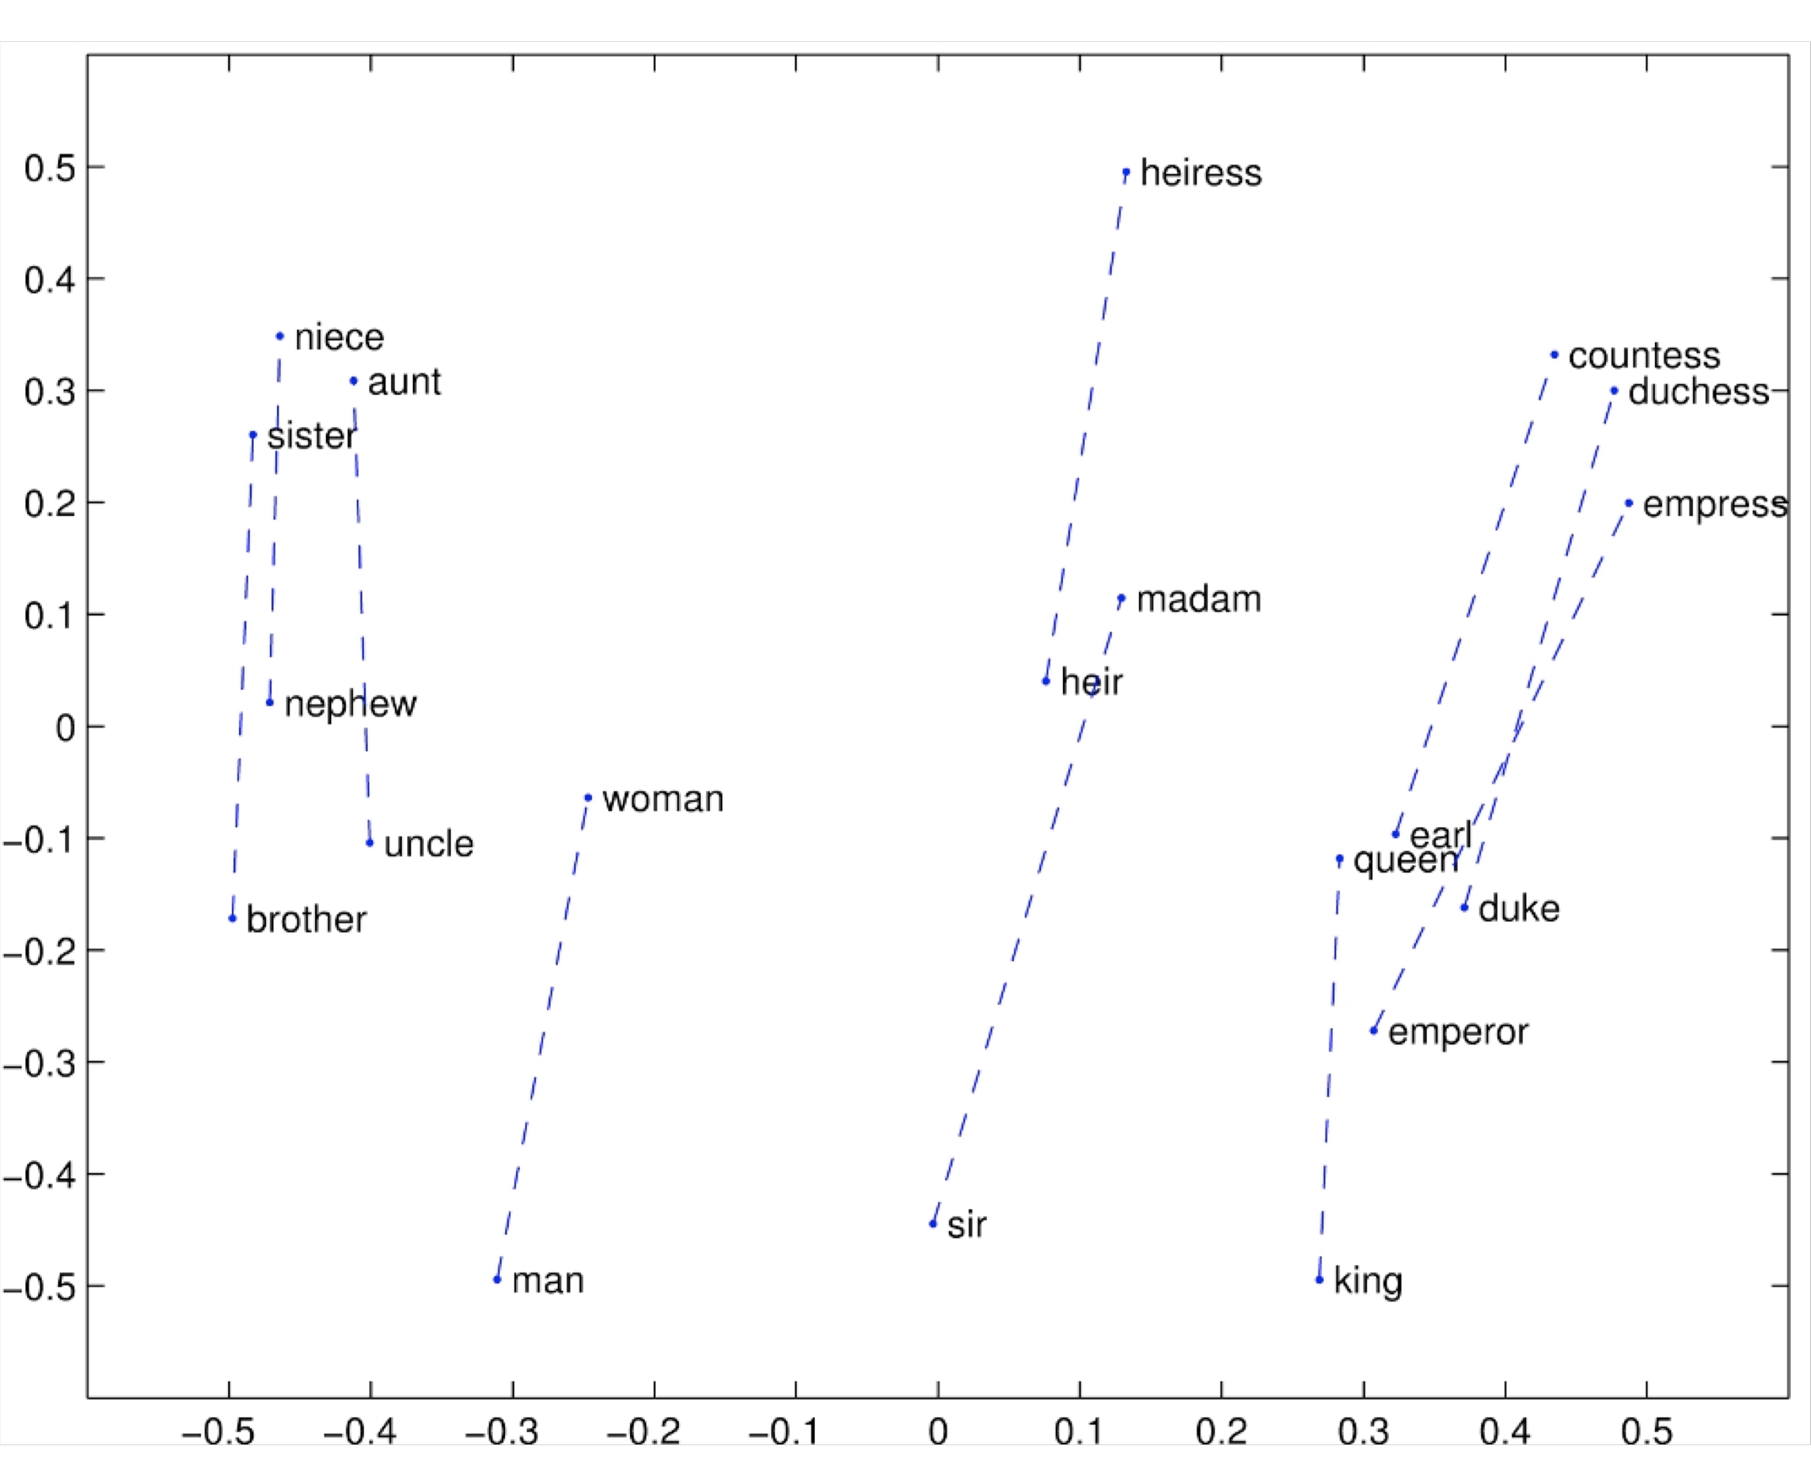
Glove Visualizations

Slide 48

Glove Visualizations: Company - CEO

Slide 49

Glove Visualizations: Superlatives

Slide 50

Details of intrinsic word vector evaluation
Word Vector Analogies: Syntactic and Semantic examples from http://code.google.com/p/word2vec/source/browse/trunk/questions- words.txt
problem: different cities may have same name

Slide 51


Details of intrinsic word vector evaluation
Word Vector Analogies: Syntactic and Semantic examples from

Slide 52
Analogy evaluation and hyperparameters
Model | Dim. | Size | Sem. | Syn. | Tot.
ivLBL | 100 | 1.5B | 55.9 | 50.1 | 53.2
HPCA | 100 | 1.6B | 4.2 | 16.4 | 10.8
GloVe | 100 | 1.6B | 67.5 | 54.3 | 60.3
SG | 300 | 1B | 61 | 61 | 61
CBOW | 300 | 1.6B | 16.1 | 52.6 | 36.1
vLBL | 300 | 1.5B | 54.2 | 64.8 | 60.0
ivLBL | 300 | 1.5B | 65.2 | 63.0 | 64.0
GloVe | 300 | 1.6B | 80.8 | 61.5 | 70.3
SVD | 300 | 6B | 6.3 | 8.1 | 7.3
SVD-S | 300 | 6B | 36.7 | 46.6 | 42.1
SVD-L | 300 | 6B | 56.6 | 63.0 | 60.1
CBOW† | 300 | 6B | 63.6 | 67.4 | 65.7
SG† | 300 | 6B | 73.0 | 66.0 | 69.1
GloVe | 300 | 6B | 77.4 | 67.0 | 71.7
CBOW | 1000 | 6B | 57.3 | 68.9 | 63.7
SG | 1000 | 6B | 66.1 | 65.1 | 65.6
SVD-L | 300 | 42B | 38.4 | 58.2 | 49.2
GloVe | 300 | 42B | 81.9 | 69.3 | 75.0
Performance is heavily dependent on the model used for word embedding
Performance increases with larger corpus sizes
Performance is lower for extremely low dimensional word vectors

Slide 53

Analogy evaluation and hyperparameters
More data helps, Wikipedia is better than news text!

Slide 54
Another intrinsic word vector evaluation
Word vector distances and their correlation with human judgments
Example dataset: WordSim353 http://www.cs.technion.ac.il/~gabr/resources/data/wordsim353/
Word 1 | Word 2 | Human (mean)
tiger | cat | 7.35
tiger | tiger | 10
book | paper | 7.46
computer | internet | 7.58
plane | car | 5.77
professor | doctor | 6.62
stock | phone | 1.62
stock | CD | 1.31
stock | jaguar | 0.92

Slide 55
Word senses and word sense ambiguity
Most words have lots of meanings!
Especially common words
Especially words that have existed for a long time
Does one vector capture all these meanings or do we have a mess?

Slide 56

Improving Word Representations Via Global Context And Multiple Word Prototypes (Huang et al. 2012)
Idea: Cluster word windows around words, retrain with each word assigned to multiple different clusters bank₁, bank₂, etc

